Slide 1
Image Trend Elite Training
2023

Slide 2
Login Credentials for Ground DEMO Account
https://gmr.imagetrendelite.com/Elite/Organizationgmr/
Username: gmrdemo
Password: GMR1234!
Notes:
If you encounter issues with this demo site take the following steps:
Submit a kayako ticket requesting unlock.
Change the username to gmrdemo1 or gmrdemo2. Use the same password. This should allow you to continue training as needed while the other account gets unlocked.

Slide 3
Elite Field Overview

Slide 4
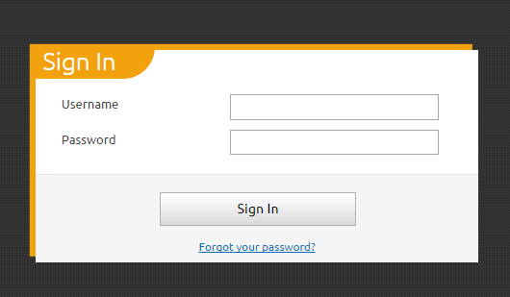
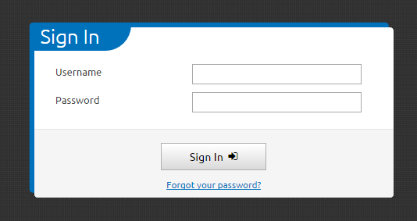
Elite Web vs Elite Field
Elite Web
Elite Field
Notes:
Note color difference for sign in screens.
Elite Field is for clinical documentation.
Elite Web is for administrative access and review of charts, revenue cycle access and review of charts, etc.

Slide 5
ImageTrend Elite Field (iPad/Toughbook)
Browser based - Elite uses the browser cache on your web browser to store information.
  You must use Google Chrome or Microsoft Edge browsers. Internet Explorer (IE) is NOT supported.
Must use company devices such as iPads or Toughbooks for application access
Charting can occur off-line
Posting requires on-line availability
Notes:
Privacy browsers will not work with ImageTrend Elite – they will dump your cache on a routine basis, and you will LOSE your chart.

Slide 6
Elite Field
Elite Field is identified by the BLUE background.
Field personnel will START all documentation in Elite Field.
Field personnel will need to login to Elite Field at the beginning of the shift. Ensure you have access, build the crew and sync resources.
This will sync the program and ensure you have the most current version of the program.

Slide 7
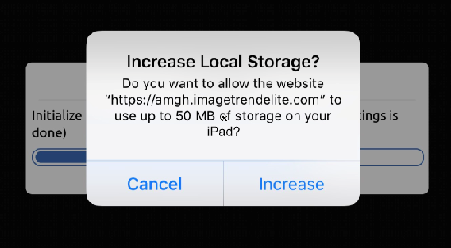
Elite Field – Increase Storage
If your browser asks you to “use additional storage”, click Increase.
Elite Field uses your browser storage to store all the data sets for the program.
If you select “cancel”, the program will not load and you will need to contact GMR Image Trend support for assistance.
This step is IMPORTANT for any operation using iPads!!

Slide 8
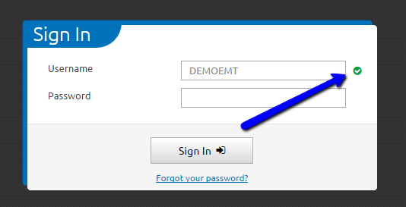
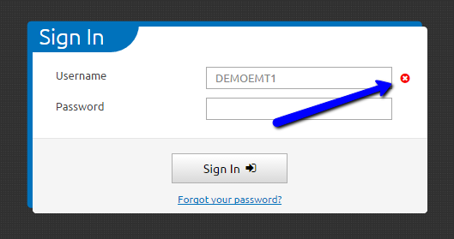
Elite Field - Login
Once you enter your username and switch to the password field. A green check mark will appear next to the username on all active user accounts. If there is a red “x” mark, the username is either incorrect or the account is no longer active.
Contact GMR Image Trend support for assistance if you continue to see this after your first login.
Notes:
If you clear your history and web data you may see the red x upon your first log in attempt. Just because you get the X – don't not attempt to sign in.

Slide 9
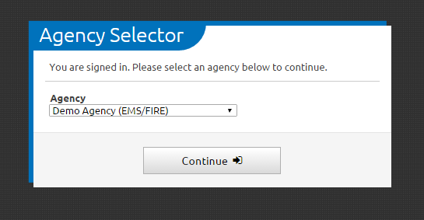
Elite Field – Agency Selector
An Agency Selector box will appear once you have successfully logged in IF you have access to more than one operation.
You will need to select the correct agency (base) location.

Slide 10

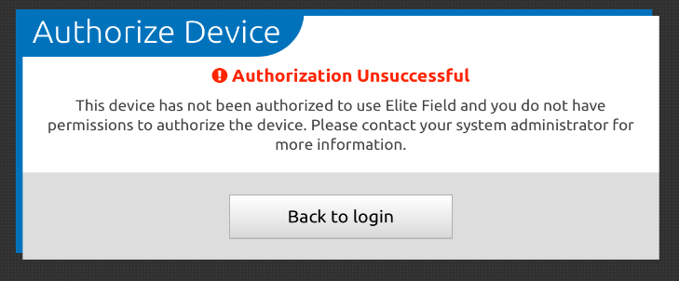
Elite Field – Authorize Devices
WARNING
All devices must be authorized to access the system. Device Authorization is approved by GMR. No personal computers or devices are allowed to access the system.
If your agency has a device that is not authorized and needs to be, contact GMR Image Trend Support.
Notes:
You may not receive this specific notification, but GMR IT will receive the notification.

Slide 11
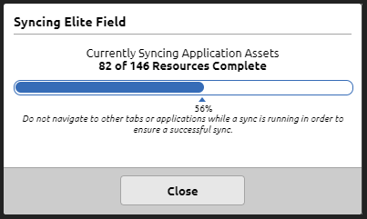
Elite Field – Syncing
Every time you login, the system will automatically sync. This is a normal process and is required for the application to function properly.

Slide 12
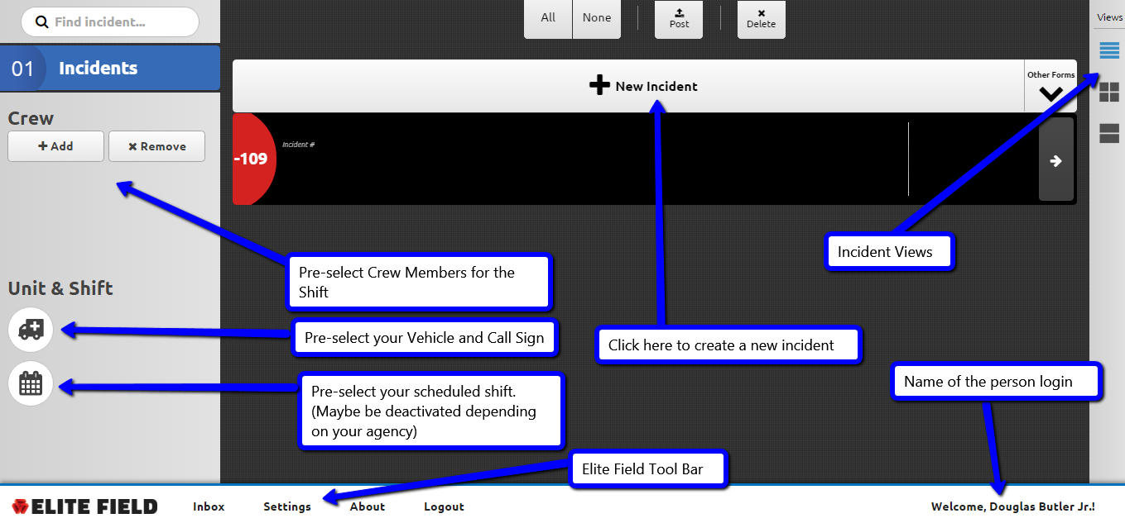
Elite Field – Home Screen
Notes:
Adding the crew would be one thing that would be good to do at the beginning of the shift. The other data like vehicle and call sign will come over from CAD data.

Slide 13
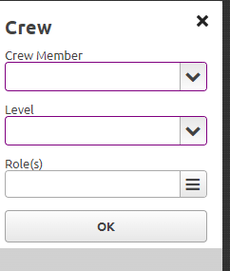

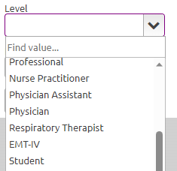
Building Your Crew
Crewmembers assigned to your agency will be available for selection from the Crewmember dropdown.
  Other EMS or Public Safety Agency at Scene, and Other Healthcare Professional designations are used to represent external providers
Each crewmember added to the incident must have a level and role assigned
  Student role is available to capture students, interns, or ride along’s.
Role assignment is for the entirety of the incident
  At scene and for transport
  You will have at least two roles selected for each crewmember.

Slide 14
Elite Field – Tool Bar
Inbox – Access CQI, Documentation, Billing and Patient Outcomes Messages
Settings – Manual Syncing, External Keyboard Settings
About – Shows what version of Elite Field and ability to submit errors
Logout – Logs you out of the system. This should be clicked prior to closing the browser.
Announcements – Messages from GMR Clinical Informatics to end users regarding ImageTrend functionality or updates.

Slide 15
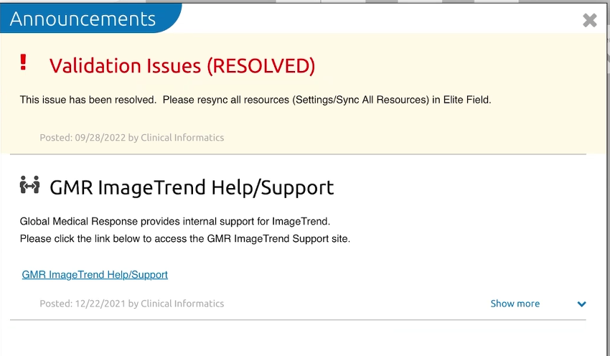
Sample Announcement

Slide 16
GMR ImageTrend Support

Slide 17
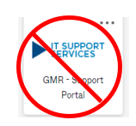
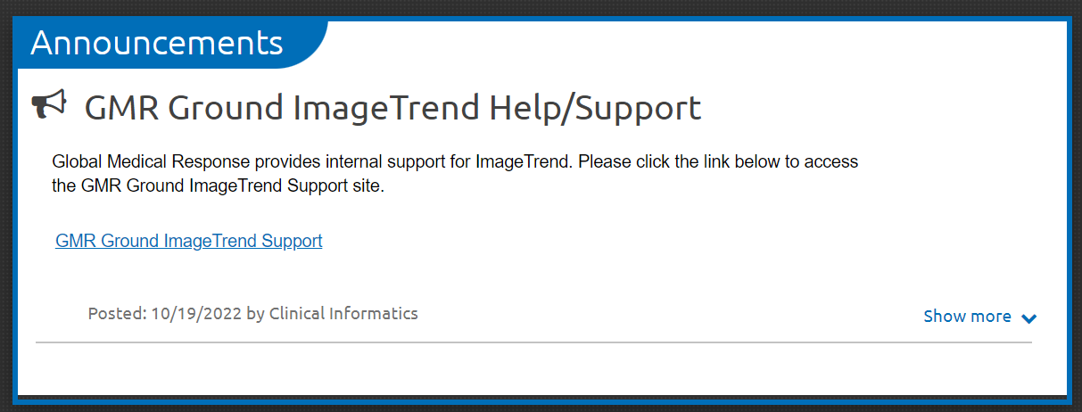
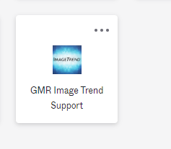
GMR ImageTrend Support
Support is provided internally by GMR Clinical Informatics
Link to the GMR ImageTrend Support Site can be found in Elite Field or Elite Web in the Announcements Section OR via OKTA.
DO NOT contact ImageTrend. DO NOT call the GMR IT Helpdesk or submit a GMR IT Service Now Support Ticket for an ImageTrend related issue. Only Use GMR Ground ImageTrend Help/Support
OKTA Chiclet
Notes:
The educator should show the crew the IMT support site to include references, how to submit a ticket, etc..
The crews should not email Informatics, all IMT support should go through the IMT support site.
The OKTA chiclet will be ready before Go Live but may not be ready during end user training.

Slide 18
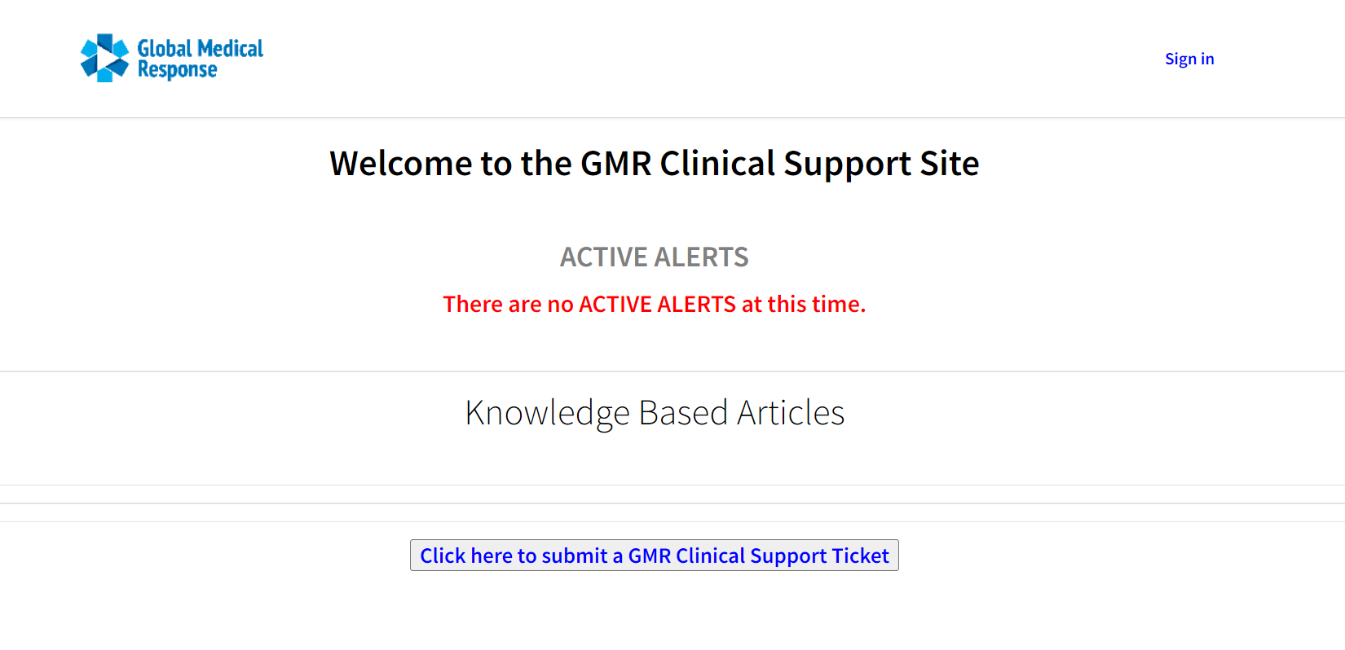
GMR ImageTrend Support

Slide 19
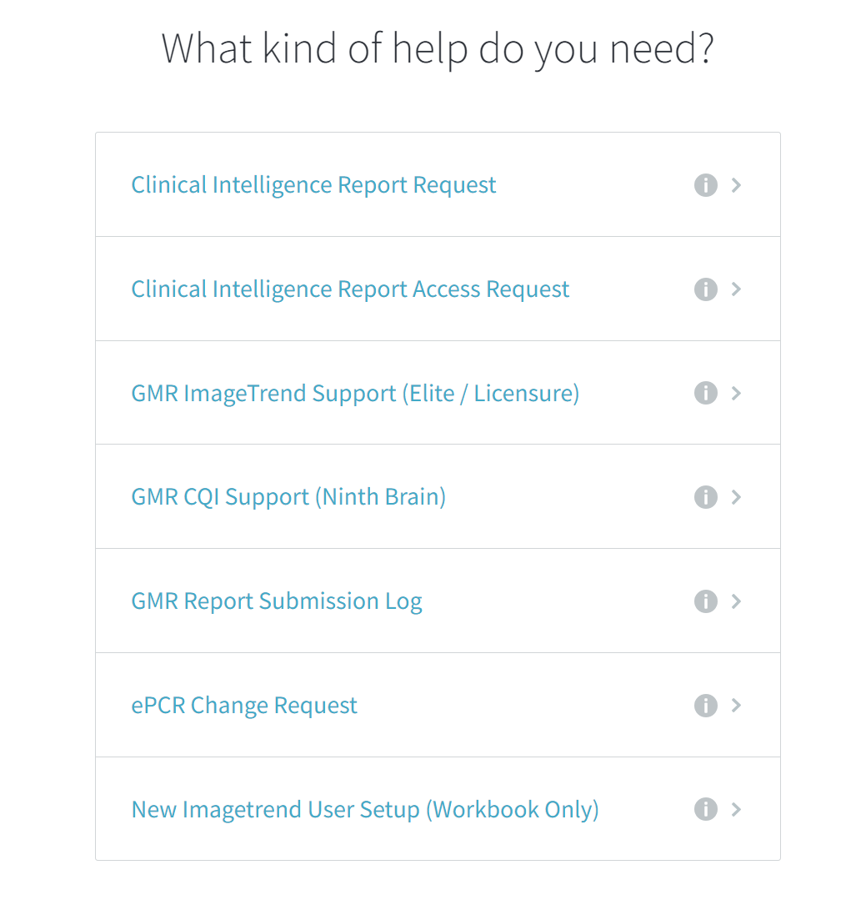
Select Elite Support for issues with clinical documentation

Slide 20
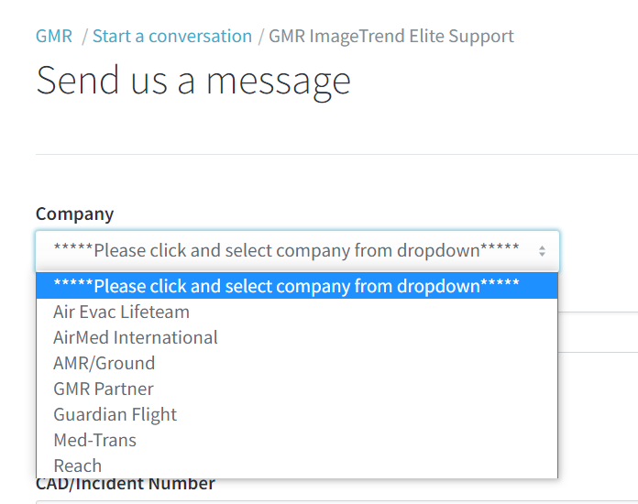
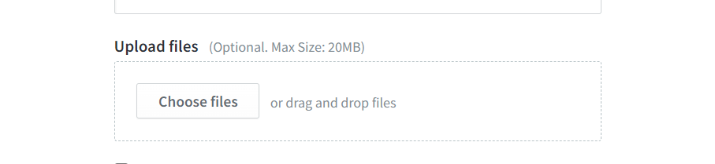
Screenshots are SUPER helpful when trying to troubleshoot and solve your problems. Upload screenshots in the “Upload Files” section.
Notes:
If there is a drop down – there is a reason we need the specific information. Please complete each and every field and be as specific as possible.

Slide 21
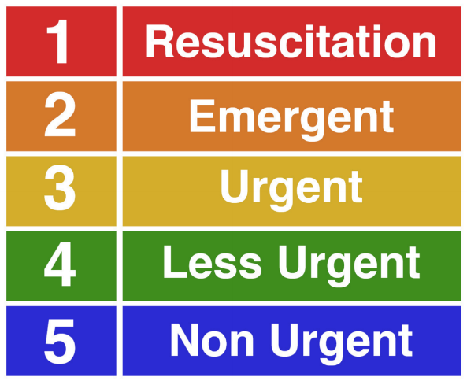
GMR Image Trend Support
Crewmembers will be required to submit a ticket for support.
All tickets are important
Support triages tickets much like patients are triaged
The better information we can get from you, the better we can triage the issue.
Support is handled internally by trained clinical staff.

Slide 22
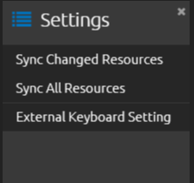
Elite Field – Tool Bar - Settings
If you experience an error in the program, the first thing you should do is Sync Resources. If you are in an active incident, close the incident and return to the Elite Field home page.
Once on the home page click on Settings link on the Elite Field Tool Bar
Once the Settings tab opens, click Sync All Resources and follow the prompts.

Slide 23
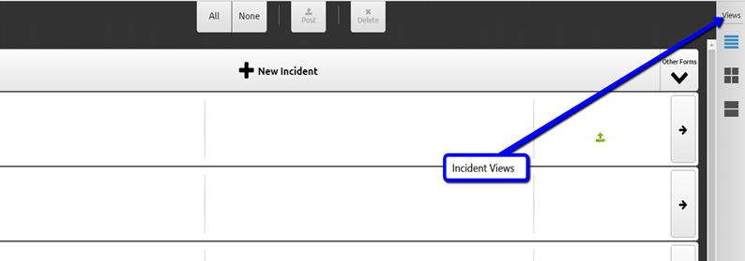
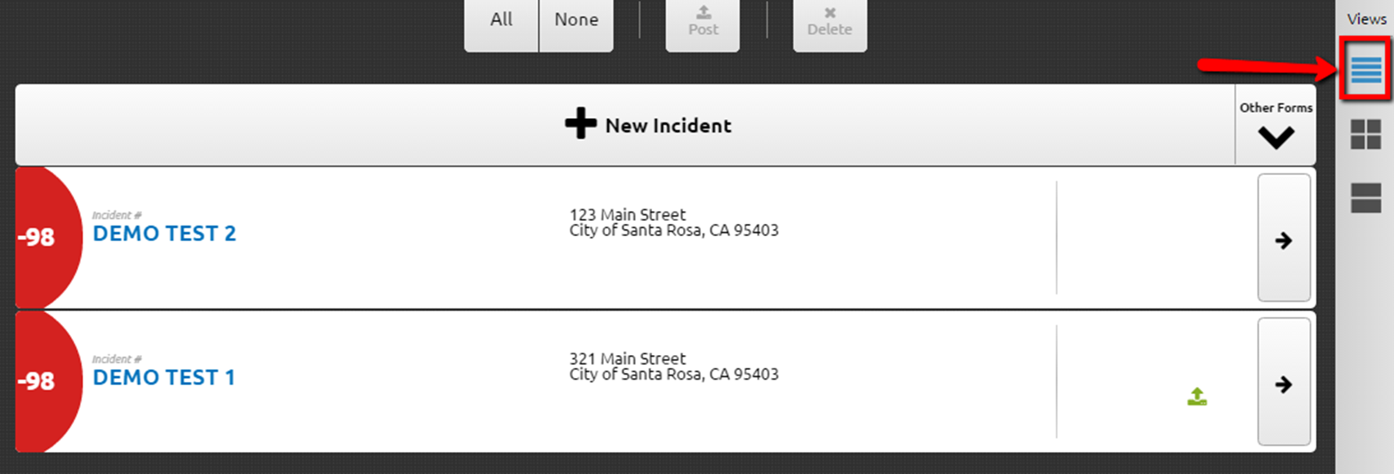
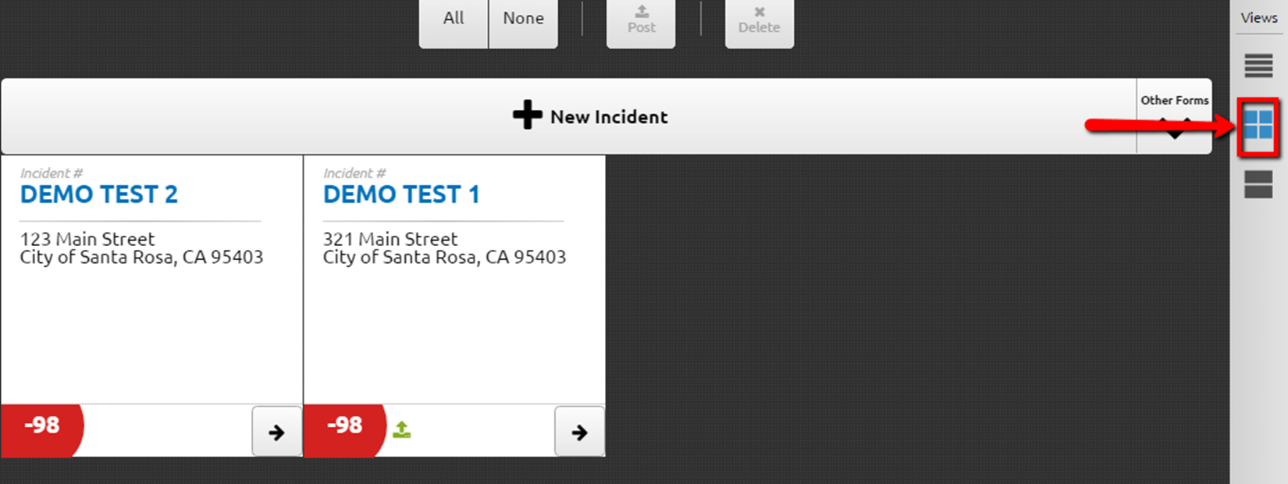
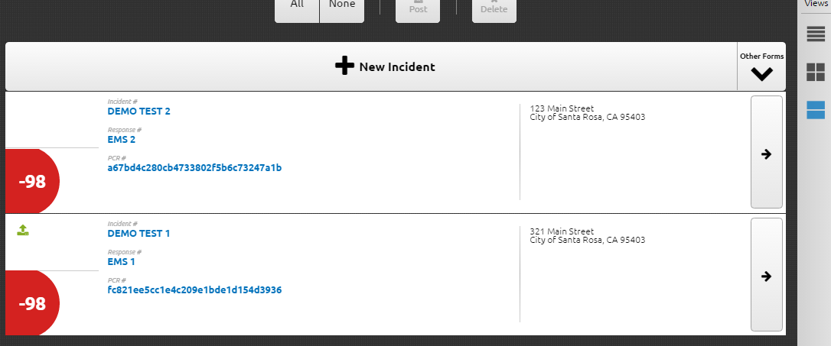
Elite Field – Incident Views
There are three incident views to chose from. They relay a variety of information.
  List
  Tiles
  Panel
Incidents will only be visible between 1-2 days depending on your agency’s call volume.
To access older incidents, you will need to login to Elite Web.

Slide 24
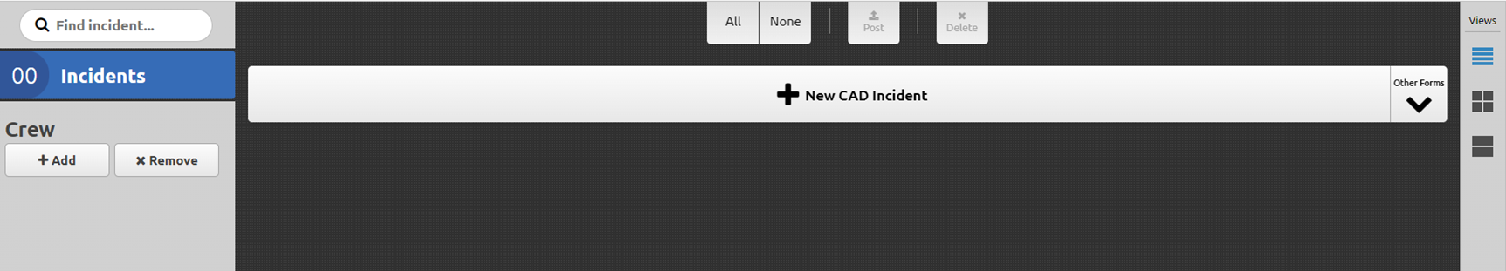
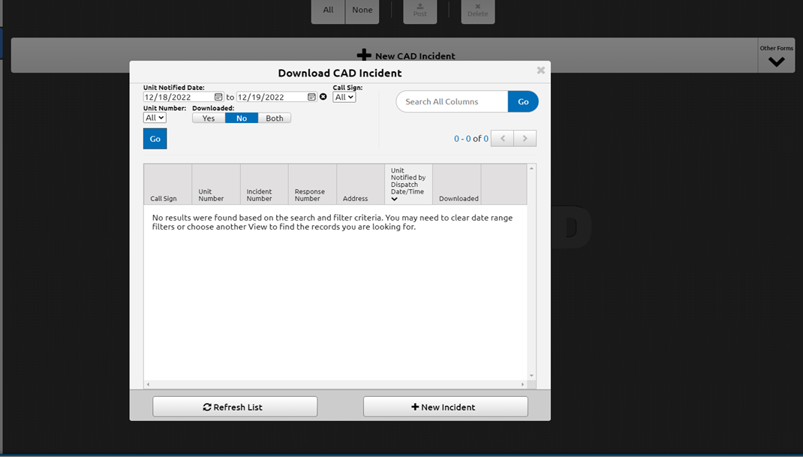

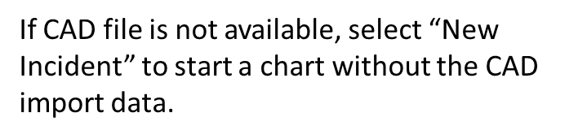
Elite Field – Adding a New Incident/Starting a Chart

Slide 25
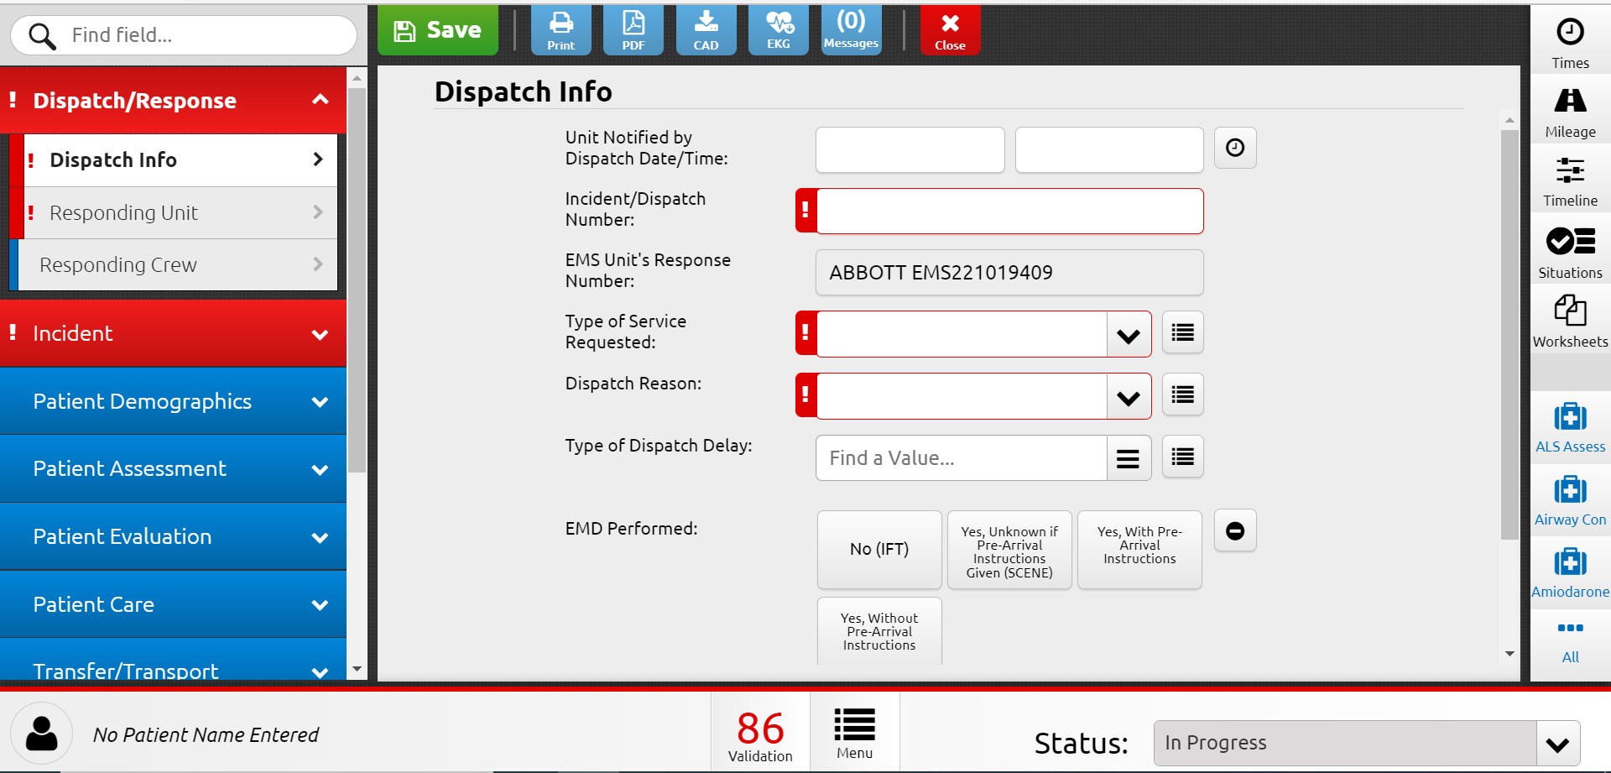
Elite Field - Overview
Action Bar
Field Search
Times
Timeline
Situations
Worksheets
Navigation
Menu
Power Tools
Validation Rule Score
Menu
Panel

Slide 26
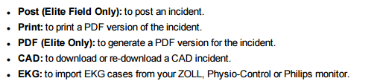
Elite Field - Action Bar
Elite Field and Web both use the same design layout to document an incident. The only difference is the action bar.

Slide 27

Elite Field - Saving
The application does an auto save each time the next button is clicked, or a different navigation menu is selected. The crew member can also do a manual save by clicking on the button.
Data is saved locally on the tablet in the browser cache. It does not “go to the cloud.”
Notes:
A real-world example would be how the browser saves information when you surf and shop on Amazon. The next time you come back to the Amazon page there is information about what you looked at previously.

Slide 28
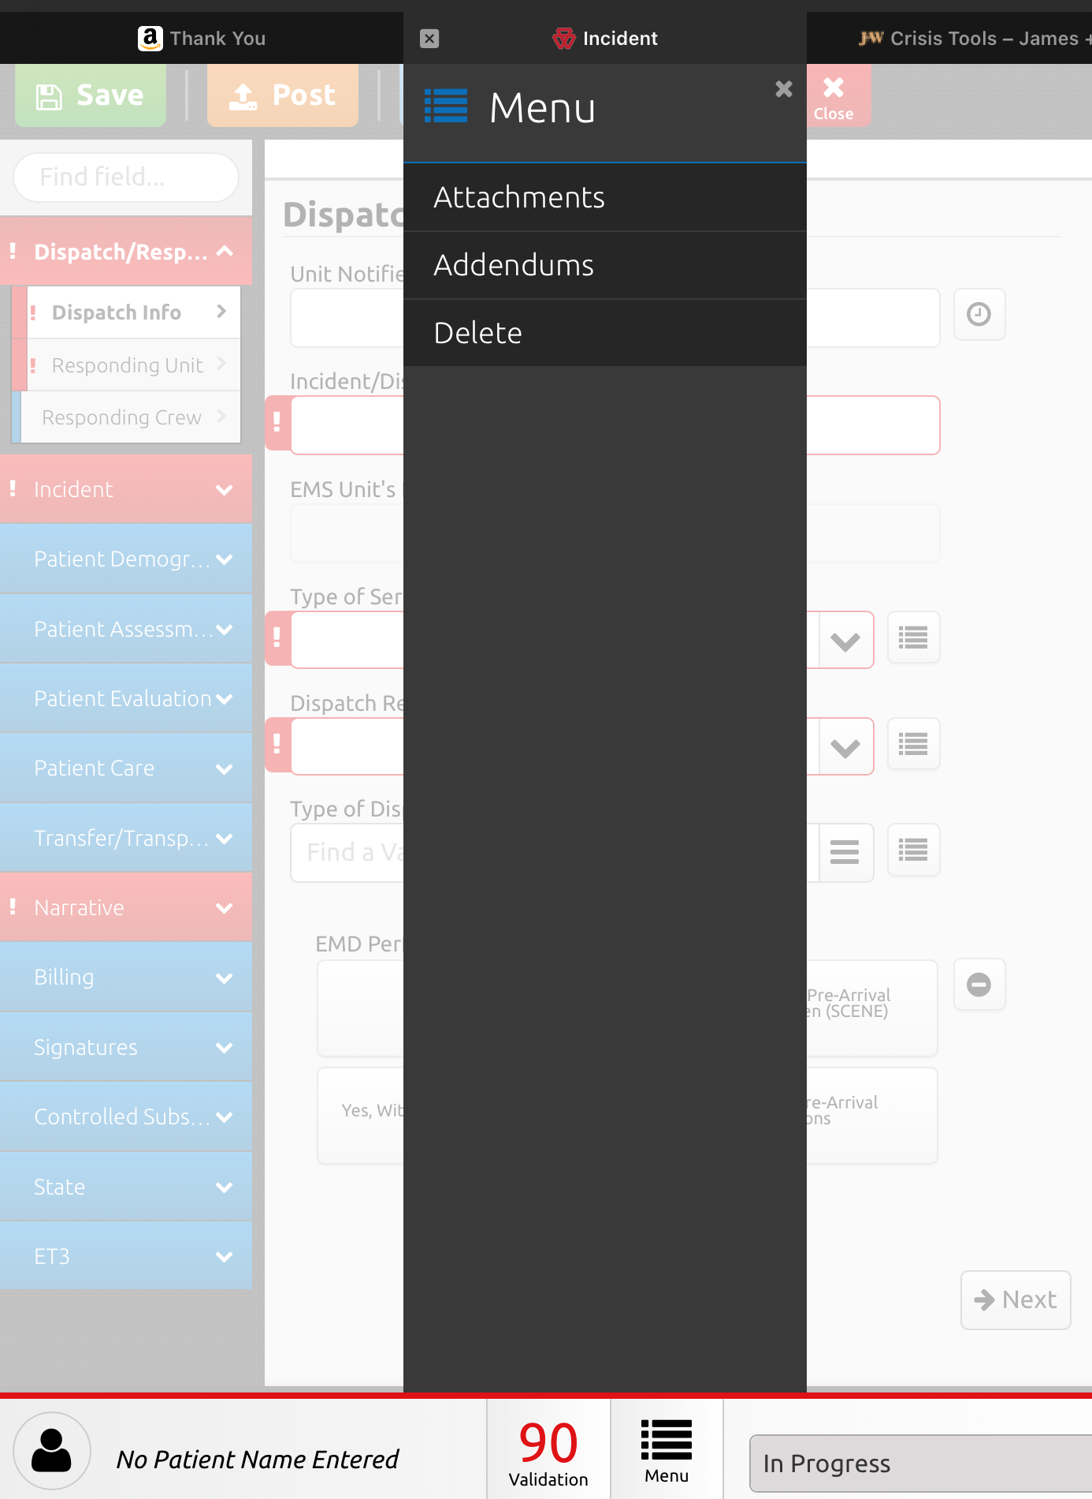
Elite Field – Menu Panel
The Menu Panel is where you will find Attachments, Addendums, Lock and Delete functions.
Crews can DELETE a chart at any time prior to it being “Posted”.
Once a chart is posted, a GMR IMT Clinical Support ticket will be required to get a chart deleted. (gmr.kayako.com)

Slide 29
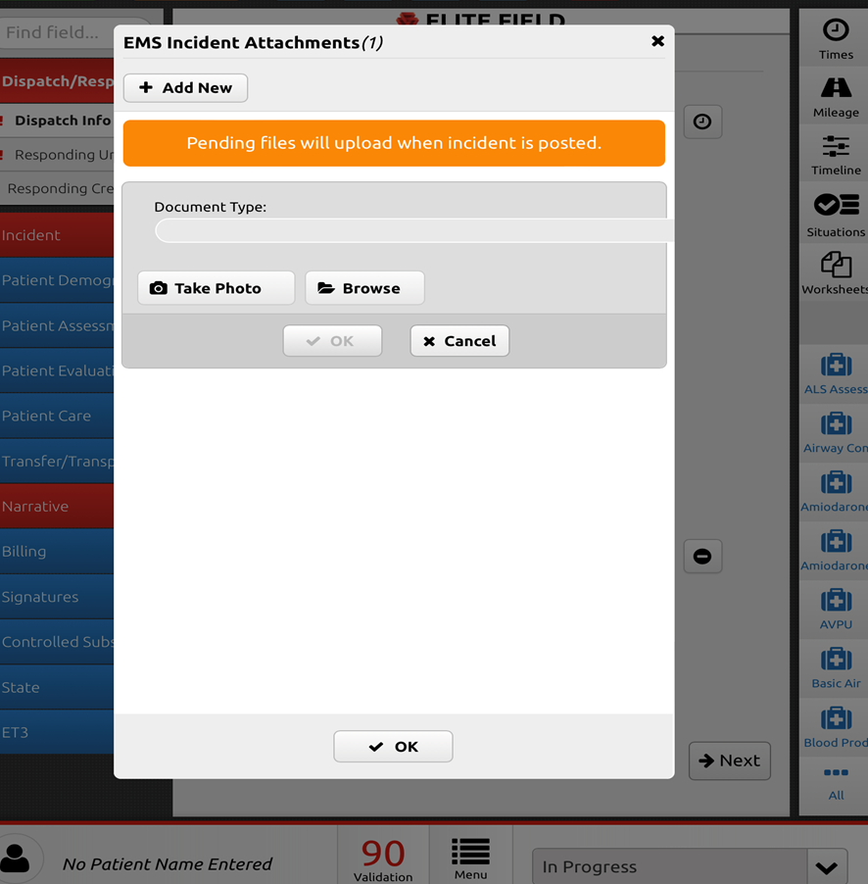
Elite Field – Adding Attachments
Notes:
Use the camera feature on your mobile device to capture images as attachments.
HIPAA compliant as it adds the picture or upload within IMT and it is not stored on your device.

Slide 30
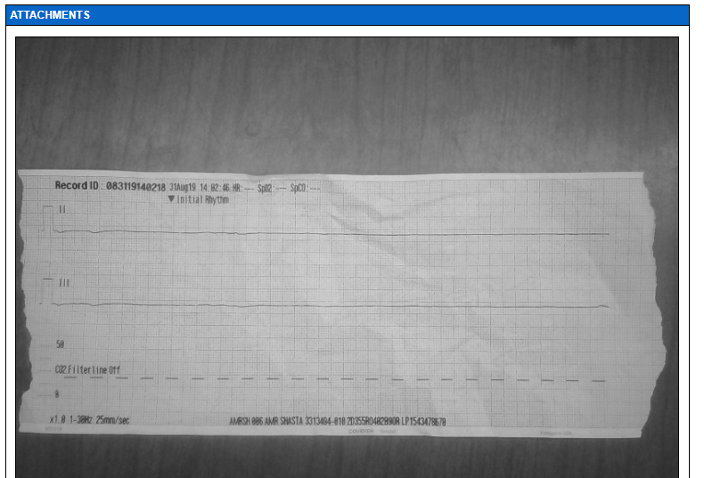

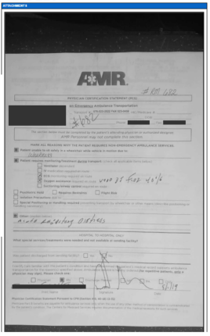
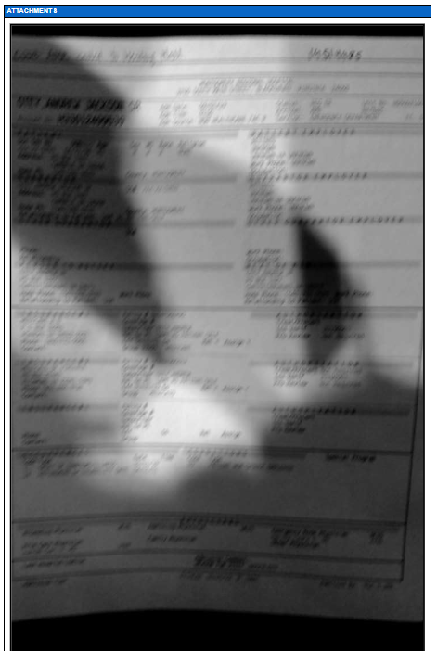

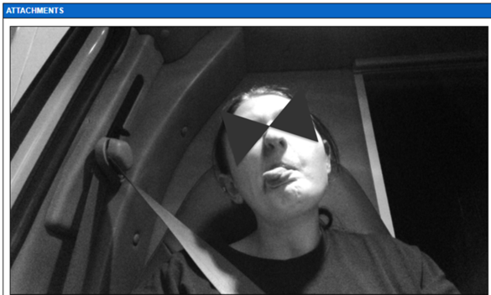

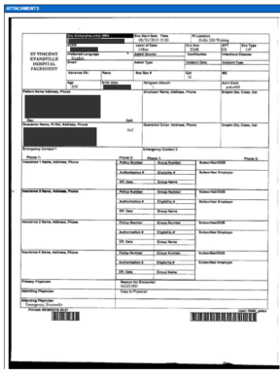
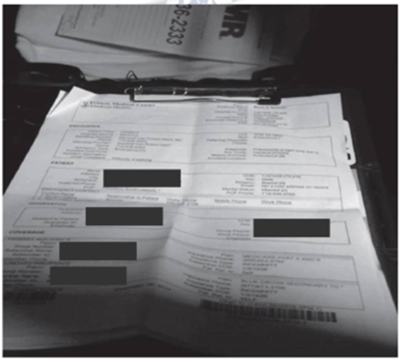
Trailing Documents – Picture Quality
Poor quality
  Shadowed/Blurred text
  Too far away to read text
  Inappropriate images or background items in pictures
Good quality
  Flat surface, text is easily discernable
  Well lit

Slide 31
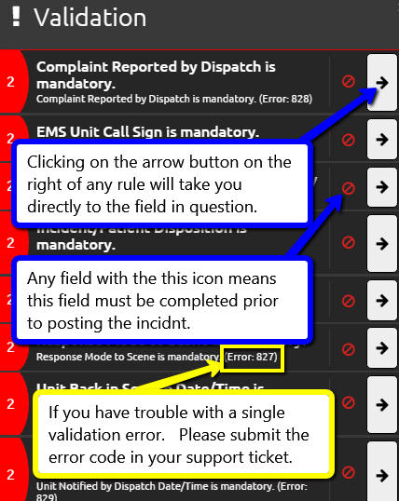
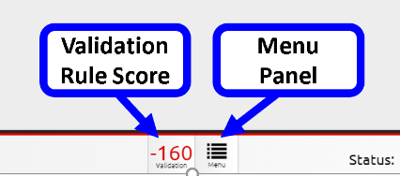
Elite Field – Validation
Validation score is located next to the menu button.
Score comes from the points assigned to specific elements of a chart.
Click on the score to see which fields/errors still exist in this incident.
Incidents should be at 100 percent validation upon completion.
Notes:
Validity rules exist for the minimum documentation requirements whether they be from the state, from NEMSIS or from GMR.

Slide 32
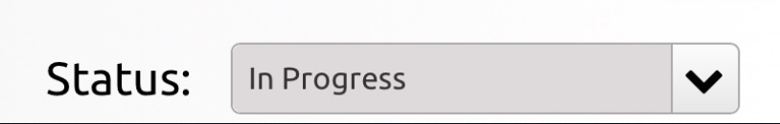
Elite Field – Status
The chart status is utilized by Revenue Cycle. End users should NOT modify this status – it is automatic.
Routine Status Options:
  In Progress
  Finished

Slide 33
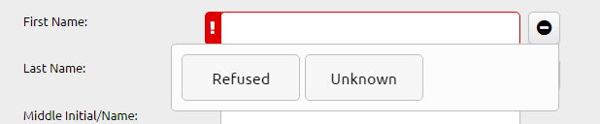
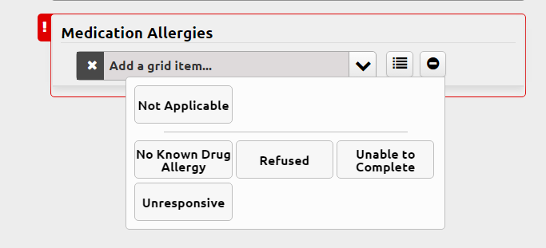
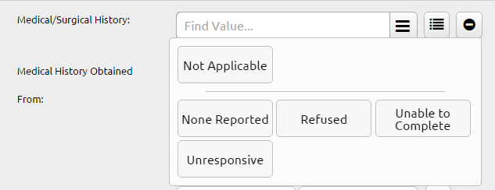
Elite Field – Pertinent Negatives (PN)
Pertinent Negatives (PN) allow you to complete your documentation without providing FALSE or INCORRECT information. PN will allow you to address and resolve validation rules items.
Example PN fields:

Slide 34
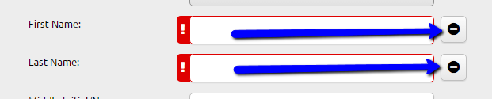
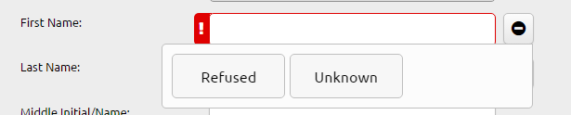
Elite Field – Pertinent Negatives (PN)
To access the PN options look for the PN icon next to the field in question.
Click the icon and the available options will display.
Please note: Not every field has PN options available.
Notes:
Pertinent negatives – options for when you don’t have the information to satisfy the field. Some states allow, some states don’t.

Slide 35



Elite Field – Patient Demographics
If you do not know the name of the patient or if the patient refuses to provide that information to you, use the PN fields. If you are provided a trauma alias, use the trauma alias for the name of the patient. This may be different based on each facility.
Field delivery of a newborn or immediate transport of one should be documented as such if no name is available:
Pertinent Negative Example
Trauma Alias Example
Field Delivery Example

Slide 36
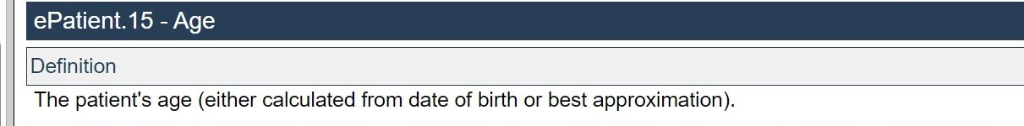
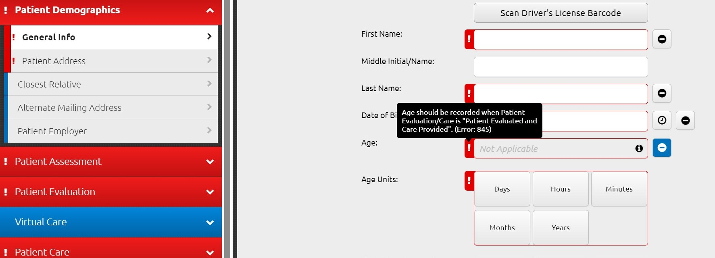
Patient Age
Numerous state NEMSIS 3.5 rules do not allow for a pertinent negative for patient age.
If you are unable to obtain definitive age information, the patients age should be estimated.

Slide 37
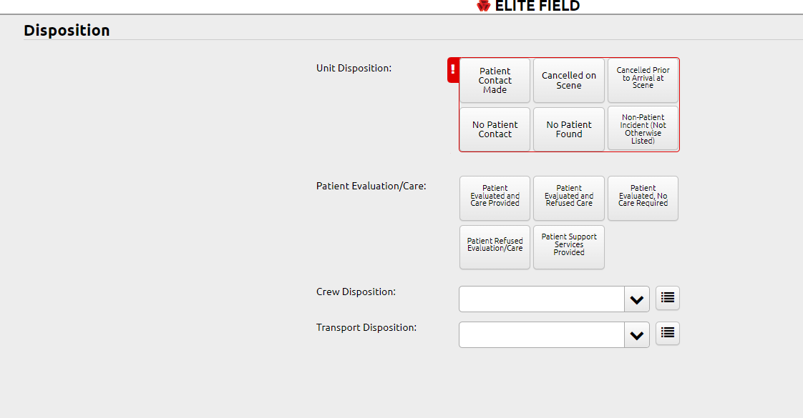
Disposition Tab
The four disposition fields pictured are new in the 3.5 template
These fields will determine the required elements for the rest of the chart.
All four fields will be required.

Slide 38
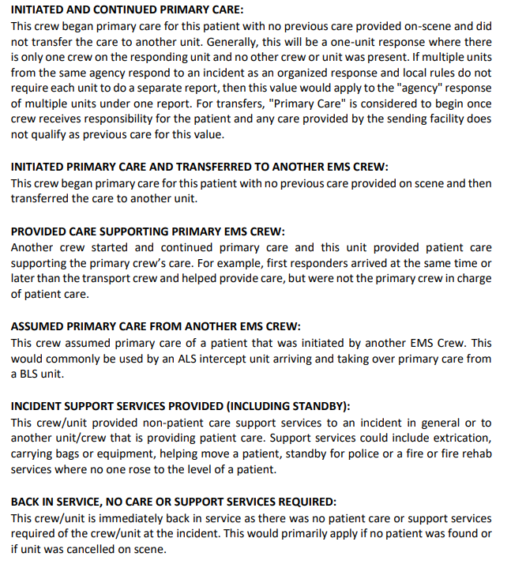



Crew Disposition Options
For the purposes of NEMSIS compliant clinical documentation, the GMR crew is considered the Primary EMS Crew for any patient they are called to transport. This is true regardless of other agencies on scene and if those agency providers administered any care.
GMR = Primary EMS Crew

Slide 39



Transport Disposition Options

Slide 40


Elite Field – Times
If a feed is available from your CAD, Dispatch Times will come from the CAD file
At a minimum, Patient Times (time of contact and movement) will need to be entered into the times section

Slide 41


Elite Field – Timeline
The timeline is the single most effective and useful tool in IMT. You can make any change or edit from the timeline.
Any edits to a Power Tool or Situation Tool must be done in the Timeline.
Each time you select a Power Tool a new entry is created.
Click on the right arrow to make changes to the existing Power Tool/Situation Tool entry.
Any entries with no associated date/time will always be in RED and at the bottom of the timeline. These issues will need to be corrected before the chart can be completed.
The Timeline should be reviewed before posting to make sure all the times are correct.

Slide 42


Elite Field – Power Tools
Power Tools are a focused entry point for clinical documentation.
The Power tools are for comprehensive clinical documentation and data collection
  Focused documentation to ensure the full picture of patient care is captured.
  NEMSIS, State and Federal, and GMR clinical quality data collection comes from within the power tools and the selections on the left side of the clinical template.
  Power Tool documentation will drive your quality reporting. All reporting is driven by Power Tool data fields.

Slide 43

Power Tool Documentation
The purpose of the crewmember fields in the power tool is to capture WHO did the procedure and that individual’s license/credential level.
The ability to bill for the procedure is determined by the role of the caregiver performing the procedure.

Slide 44

Elite Field - Procedures
Procedure Documentation Changes
All procedures are documented as 1 (ONE) attempt made regardless of success. If more than 1 (ONE) attempt was made, a second additional procedure will need to be documented and so forth.

Slide 45



Elite Field – Assessments / Exams
Use the Assessment Power Tool to document your assessment.
You can use the “Tag Normals” or “Tag Not Done” to complete systems assessments.
Select a system to open the assessment fields specific to that anatomic site or system.

Slide 46


Tag Not Done
Notes:
Orange in color
Tag Not Done = You can not assess something.
IE. You cant assess the back, you would “Tag not done”.

Slide 47

Tag Normal
Notes:
Normal = Blue
Normal = you assessed the body part and found nothing wrong. Tiles turn blue when marked as Normal. Marking a specific body part as Normal turns the body tile green until you mark all the specific body parts as Normal, then the tile turns blue.
Not Done = you did not assess the body part. Tiles turn orange when marked them as Not Done.
You cannot mark specific body parts as Normal or Not Done, only whole body parts.
Not Present = the patient does not have the body part.

Slide 48

Exam Findings Not Present (NP Tag Mode)
NP Tag Mode is used to document things you didn’t find during your assessment. NOT things you didn’t assess, but rather things you looked for, but didn’t find. (Like digits or extremities or abnormal heart sounds)
Notes:
NP Tag Mode is used to document things you didn’t find during your assessment. NOT things you didn’t assess, but rather things you looked for, but didn’t find. (Like digits or extremities or abnormal lung sounds)
The heart sounds assessment is a good example of an appropriate place to use the NP Tag Mode. Ideally, a critical care provider would assess for rubs, murmurs or clicks, when listening to heart sounds. By using the NP tag mode, you are confirming that you provided a critical care assessment and didn’t find any abnormalities. This is very different than just documenting “normal” throughout your assessment.
NP = “Not Present”

Slide 49

Documenting Assessment Findings
Need to document assessment findings but don’t see the option you are looking for?
Select the “Details” button and a text box will open for you to add additional information.

Slide 50

Re-Assessments
All re-assessments should be completed using the “Assessment” power tool.
  Any change from your initial assessment needs to be documented using the Power tool.
Notes:
I’ve seen where a crew documents one assessment in the power tool but has a lot of changes during our care and no reassessments documented. Seems the narrative is being used to document the changes to assessments, rather than using the power tool.

Slide 51


Elite Field - Situations
Situations combine multiple power tools so crewmembers can logically document through a routine procedure/situation.

Slide 52

Read Only Tabs
Read only tabs in ImageTrend exist to give you the ability to delete information.
The information in these tabs will come from your documentation in other parts of the chart and/or from the monitor import.
You can’t modify the entry. You can only delete from this section.
Modifications can ONLY be made in the power tool and/or via the timeline entry.

Slide 53

Interfacility Transport Justification
The chart drop downs associated with the reason for transport and the capabilities associated with the receiving facility are typically not enough for payers to determine if the patient was transported to the most appropriate facility.
The text box included in the transfer/transport tab is included so that you can provide additional information or justification as appropriate.

Slide 54


CMS Level of Service
CMS considers the level of service based on the care that was provided to the patient and only if the care provided is reasonable and necessary.
The level of care is determined based on the state and local regulations that govern the EMS Agency and their staff.
You will select the level of service you are providing based on the definitions provided.
This field is NOT used to determine billing status.
Notes:
This is NOT a GMR Billing Field. This is a NEMSIS 3.5 field and is used for data collection purposes. We do not expect you to change the way you take care of patients to achieve some type of level

Slide 55

ALS Assessment
Caregivers must complete the Power Tool to document the ALS assessment “procedure”
MUST be performed by an ALS provider
You MUST document WHO completed the procedure of ALS Assessment
You MUST document the ROLE of the individual that completed the ALS Assessment.
This is a billing field and does NOT replace the need for a full patient assessment using the Assessment Power Tool.

Slide 56
Worksheets
Worksheets populate based on your answers to questions throughout the template.
If a worksheet is present, you must complete it.
Worksheets exist for billing, refusals, and tiered responses.

Slide 57

AOB/MSS/ABA
Notes:
All transports require a signature from either the patient, which is the gold standard, a patient’s representative, or the receiving facility. The signature is an attestation for three things. First, the signature proves that we transported the patient to the destination. Second, the signature allows us to bill on the patient’s behalf. Third, the signature indicates we’ve advised the patient of our privacy practices and that we won’t share their protected health information with anyone other than those involved in their care.
The signature form goes by several names.
AOB – Assignment of Benefits
MSS – Master Signature Statement
ABA – Ambulance Billing Authorization

Slide 58
ABA Form Sections
Notes:
The Ambulance Billing Authorization form has three sections.
Section 1:
This is the patient signature section and is the expected signature for all patient transports. However, we realize it’s not reasonable to expect crews to get a patient signature in all cases. When it is not possible to obtain the patient’s signature, clear documentation related to why the patient’s signature was unobtainable is mandatory.
Section 2:
This is the patient’s representative’s signature. This is the second best signature if the patient’s signature cannot be obtained. The only people who can sign for the patient are legal guardians, relatives or other people who receive governmental benefits on the patient’s behalf, or a relative or other person who arranges the patient’s treatments or manages the patient’s affairs.
Section 3:
This section should be used ONLY if section 1 or 2 are not possible. If section 3 is used, the signor is someone from the RECEIVING facility, not the sending facility. This is important as the Master Signature Statement is proof we transported the patient to the receiving location. The full name of the signor and their title is required as we must be able to identify the signor if there is a dispute. One of the crew members is also required to sign as a witness to the facility signature. Please note and be able to advise the facility signor that their signature is NOT an acceptance of financial responsibility. Their signature is solely indicative of the fact that we transported the patient to that facility on the date of service.

Slide 59

Elite Field – Worksheets (Ambulance Billing Authorization)
The ABA worksheet will be available in the billing section of the chart.
  This section will ONLY populate if you select that the patient was treated and transported.

Slide 60
Signatures
Notes:
Signatures are a vital part of the PCR given the PCR is a legal document. Because the Master Signature Statement signature serves as proof of transport and the ability to bill on the patient’s behalf, we need to strive for the gold standard of obtaining the patient’s signature. When we are unable to obtain the patient’s signature, we can’t legally bill on their behalf as the relationship with the insurance company is between the patient and the insurance company, not GMR and the insurance company. As such, the patient has to get involved in the process and it takes time and effort. If we are truly advocating for the patient, we are doing all we can upfront to keep them from having to deal with issues on the backend.
Of note, if a patient truly refuses to sign the PCR, they will be responsible for the bill as they are essentially indicating that we cannot bill on their behalf. Please make sure you have advised your patient why you need their signature. If they still refuse, let them know they will be responsible for the bill. Remember, if you don’t obtain a patient or representative’s signature, the receiving facility will have to sign indicating we transported the patient to that facility on that date of service.
Lastly, if you are unable to obtain the patient’s signature, you MUST be able to substantiate why you couldn’t get the patient’s signature. Again, the patient’s signature is the gold standard. If the choice is to deviate from that gold standard, the reason must be clearly documented in the PCR.

Slide 61




Billing – Ambulance Billing Authorization (ABA)
Will be required for all transports
Depending on the answers provided in the ABA Section of the Billing Navigation Menu the worksheets will change to allow the appropriate signatures needed to correctly complete the form.
Patient able and willing to sign? Required worksheets will pop up on the right-hand side of the screen. Select the Worksheets button to show all required sheets.

Slide 62


Billing – Ambulance Billing Authorization (ABA)
Patient unable to sign, but authorized representative is available and willing to sign – the authorized representative signature form will appear.

Slide 63



Billing – Ambulance Billing Authorization (ABA)
Patient unable to sign, and no authorized representative is available to sign – the ambulance crew and receiving facility signature form will appear.
Receiving facility signature must include, at a minimum, first initial, full last name and credential.

Slide 64


Billing – Ambulance Billing Authorization (ABA)
Got a paper ABA/Signature form?
  The crewmember attestation form will appear.
You must add the paper form as an attachment to your completed chart.

Slide 65


Billing – Ambulance Billing Authorization (ABA)
No signatures and no paper ABA/Signature form?
  Attach a receiving facility facesheet and complete the Ambulance crew signatures form will appear.
You must add the facesheet as an attachment to your completed chart.

Slide 66
PCS and MNC
Notes:
Per Federal Regulation Code 410.10, before an ambulance company can file a claim for a non-emergency ambulance transport of a Medicare patient who is under the direct care of a physician, a PCS or MNC must be obtained. A PCS is a Physician Certification Statement and an MNC is the Medical Necessity Certification. Although often used synonymously, there is a difference between the two.
The MNC is the most common medical necessity form you, as a crew member transporting a non-emergency Medicare patient from facility to facility, will see. The form has three sections…a patient demographic section, a medical necessity section, and a signature section. All three must be completed for transport of the patient.
The demographic section must include the date of transport, patient’s name, and from/to locations at a minimum.
The medical necessity section can only be completed by the sending facility as this section explains why the patient has to be transported by ambulance. This section should include detailed information on why the patient can’t be transported by any other means.
The signature section requires a signature attesting to the information on the form. The signor must print their name and then sign and date the form. Their credentials are required for the form to be considered valid. Only certain people can sign the form, so it is imperative to confirm credentials. Allowed signors include physicians, registered nurses, discharge planners, nurse practioners, physician assistants, certified nurse specialists, licensed practical nurses, case managers, and licensed social workers.
As the healthcare provider transporting the patient, it is your responsibility to review this form. There may be situations where the documented reason for ambulance transport is not observed by you at the time of transport. It is important to clarify this at the time of transport by talking with the sending facility staff overseeing the patient. Ultimately, however, it is important that you assess the reason for transport and document your findings in the PCR. If there is a conflict, the documentation of your assessment and treatments are the most important in supporting why the patient needed the medical care.
The PCS is a form that can ONLY be signed by a physician, thus leading to its name. This form is used for repetitive patient transports and is not typically provided to the crew at the time of transport. Instead, the form is obtained when it is identified the patient will be a repetitive patient. Repetitive Patients are those transported three or more times in a 10 day period OR 1 trip per week for at least 3 weeks for treatment of the same condition. Examples include dialysis transports, wound care, or radiation treatment. There is a significant amount of paperwork required for repetitive patients, and that paperwork is managed nationally by a team of Repetitive Patient Specialists.

Slide 67


Elite Field – Worksheets
Notes:
Complete all fields/sections at the time of patient contact

Slide 68
Trailing Documents
Notes:
As part of the comprehensive medical record, there are many forms that get attached to the PCR. Forms include face sheets, the MNC, EKG strips, medication lists, discharge notes, transfer paperwork and others. These forms should be attached to the PCR using the photographic capability of the PCR software and the device being used for documentation. As the author of the PCR, it is your responsibility to ensure the forms are clear and readable. Although it can be difficult to use the camera on the device to capture clear images, it is imperative as the documents are part of the official medical and legal record.
Of note, any clinical images attached, such as an EKG strip, must be properly documented in the appropriate fields of the PCR. Simply attaching the EKG strip is not enough. The EKG procedure and findings must be appropriately documented in the procedure fields. Similarly, medication lists should not just be attached and forgotten. Documentation of the patient’s medications must be included in the medical history of the PCR.
Trailing document attachment is the responsibility of the crew. The PCR is not complete if there is missing or unreadable information. Ensure you have a complete PCR prior to closing the record.

Slide 69
Elite Field – Adding Attachments
Notes:
Use the camera feature on your mobile device to capture images of trailing documents as attachments.
HIPAA compliant

Slide 70
Demographic Summary
In Summary:
A complete patient care record includes accurate and documented demographics and general information
A complete patient care record is key to ensuring patient advocacy throughout the patient’s GMR experience
Notes:
Being an advocate for your patient goes beyond amazing clinical care. Being an advocate is ensuring your patient’s encounter is managed from the time our services are requested all the way through the billing cycle. Being an advocate includes capturing all the demographic information so the patient care record can flow through the GMR system of checks to all the other systems that require a complete patient care record such as hospital systems, clinical review systems, and billing. To ensure the best in patient advocacy, make sure your patient care records are solid not only clinically, but with the necessary demographic information as well.

Slide 71


Elite Field – Posting an Incident (Upload to the Cloud)
“Posting” moves a chart from the device cache to the IMT Cloud Server.
If you don’t post your charts, they will be STUCK on the device and are at risk to be LOST.
You can post an incident as many times as you would like once you clear the closed call rules.
When posting, you will be prompted and asked if you want to override, click post.
You will need to post charts for that chart to appear on Elite Web.
You will need internet connection to post an incident.

Slide 72

Elite Field – Posting Reminder
A reminder will pop up every time a chart is closed on a device reminding the user to POST the chart

Slide 73



Unable to Post a Chart

Slide 74
Auto-locked charts
Chart has been started, but not finished.
336-hour window – for now.
At the end of each shift, POST all charts that are on the device before handing off to another shift.
Posted charts can be finished without unlocking.
  If additional documentation is required, submit a GMR IMT Support Ticket (Kayako) to request unlock.
  Unlock will start the 336-hour clock over

Slide 75


Elite Field –Final Incident Posting
Posting and Finishing charts are two separate actions.
Once you have completed all of your documentation, you will need to post/re-post the incident. Once you click post, the post incident prompt will appear. Check the “Mark EMS Incident as Finished on Post” box and click post. The incident now will be locked and marked as “Ready for Billing.”

Slide 76

How Do I Know if My Chart is Marked FINISHED?
Charts have to be FINISHED to go to Billing.
To verify the chart is Finished, look for the green checkmark in the lower right-hand corner
Your chart status will also automatically change to “Ready for Billing”

Slide 77
Common Scenarios

Slide 78

Cancelled Prior to Arrival
Because a dispatch record exists, a basic chart will need to be created.
Minimal fields required
  Dispatch/Response
  Incident
    Select Cancelled PTA
  Narrative
    Brief narrative describing who called you, why you were called, and who cancelled you.
  Sign the chart
This basic documentation protects you in the event there is a legal inquiry or investigation resulting from the cancellation
Required for NEMSIS compliance
Notes:
Long term solution = automate chart from CAD data. (On Project Plan)

Slide 79

Cancelled on Scene
Because a dispatch record exists, a basic chart will need to be created.
Minimal fields required
  Dispatch/Response
  Incident
    Select Cancelled on Scene
  Narrative
    Brief narrative describing who called you, why you were called, and who cancelled you.
  Sign the chart
This basic documentation protects you in the event there is a legal inquiry or investigation resulting from the cancellation
Required for NEMSIS compliance
Notes:
Long term solution = automate chart from CAD data. (On Project Plan)

Slide 80

On Scene, No Patient Found
Because a dispatch record exists, a basic chart will need to be created.
Minimal fields required
  Dispatch/Response
  Incident
    No Patient Found
    Patient Evaluation/Care is N/A – use the Pertinent Negative option
  Narrative
    Brief narrative describing who called you, why you were called, and your efforts to locate a patient.
  Sign the chart
This basic documentation protects you in the event there is a legal inquiry or investigation.
Required for NEMSIS compliance

Slide 81

Response, Evaluation & Treatment with Transport by another unit
Notes:
Another EMS unit – anyone (unit or crew) other than the unit providing primary care

Slide 82

Patient Evaluated – No Treatment Required/Released or No Transport
Requested for a specific patient
Upon assessment and evaluation, no abnormalities or irregularities requiring medical intervention are found.
Not the same as a refusal of care
  No requirement to obtain refusal

Slide 83

Patient Evaluated – Treatment Provided but Released/No Transport (Treat and Release)
Requested for a specific patient
Local authority or Medical Director has authorized your ability to provide treatment and NOT transport the patient.
  Op specific protocol must be in writing
Assessment and evaluation completed, VS obtained, and treatment provided.
  Glucose administration, bandaging/splinting, oxygen assistance, etc.

Slide 84


Patient Contact Made – Refuses Evaluation, Care, and/or Transport
Refusal can be for any or all the following:
  Evaluation
  Care
  Transport
Reason for Refusal must be documented
Triggers requirement to complete refusal assessment, worksheets, and obtain signatures

Slide 85

Non-patient incident documentation
Any response that is supportive to another agency, an event or incident, and is NOT related to a specific patient.
Examples include:
  Fire rehab
  Standby assignments

Slide 86
Elite Web Overview

Slide 87

Elite Web
If you need to make changes to an Incident or access any of the other modules, you will need to use Elite Web. You will use the same username and password.

Slide 88

Elite Web – Homepage
Help
View Incidents, CQI, and access Elite Field
Announcements
Agency Select
Check Image Trend Internal Email
Elite Web’s homepage looks completely different than Elite Field.
Differences about Announcements -
Change password
and log out

Slide 89

Elite Web – Incident Tab - EMS

Slide 90

Elite Web - Incident List
Once you click on “View Existing” and select EMS the incident list will load.

Slide 91


Slide 92


Elite Web - Incident Documentation
Elite Field and Web both use the same design layout to document an incident. The only difference is the action bar. There is no “Post” button in Elite Web. All actions are immediately saved on the server. Note: Elite Web requires constant internet to function.

Slide 93



Elite - Inbox
When you login to either Elite Field or Elite Web you will see a number next to the inbox button. This number represents any unread messages.
If you are in Elite Field, you will need internet connection to access your Inbox. An Inbox prompt will appear and remind you that you have messages waiting. Elite Web will take you directly to your Inbox.

Slide 94

Elite - Inbox View
Text

Slide 95
Elite Web vs Elite Field
 | Elite Web | Elite Field
Purpose | “Operational” Functions related to Documentation. | Data Entry Designed for Pre-Hospital Documentation
Modules Access | Yes You can only access modules from Elite. Access to Modules depends on permission groups. | Inbox Only
Addendums | Yes | Yes
Incident Viewing | Yes | Limited Only stores non-posted incidents for up to 4 days

Slide 96
Elite Web vs Elite Field
 | Elite Web | Elite Field
Internet | Requires Internet Loss of Internet connection may result in a loss of unsaved data. | Internet Not Required Create incident while on or offline. Data saves if Internet connection is lost.
Syncing | No Syncing Required Syncing is not required to update resources | Syncing Required Syncing is required to update resources such as users, vehicles, validation rules, etc.
Post | No Post button You are connected to the main system and your incident saves there. | Posting Required In order to post internet connection is required.

