Slide 1
Contra Costa County
Telestaff Training

Slide 2
Overview in Brief
Telestaff manages the staffing schedule for the AMR Contra Costa County Deployment
This overview is intended familiarize employees with the functions that allow employees to manage their schedule.

Slide 3
Telestaff Workflow
1. Attempt to process all steps in Telestaff yourself using the resource and training tools provided
2. Urgent issues within 24 hour timeline?
Contact the Supervisor with assistance and questions; They will guide you to the next process
concordscheduling@evhc.net
Central Supervisor 925-250-9546
East Supervisor 925-250-8553
West Supervisor 925-250-8552

Slide 4
Using Telestaff
The various Telestaff processes for managing a schedule are very similar
Starting with the Log In
Navigating from the Dashboard to the Calendar
Selecting Dates to request PTO, Giveaways, Trades or Availability
Each section below will describe each individual process

Slide 5
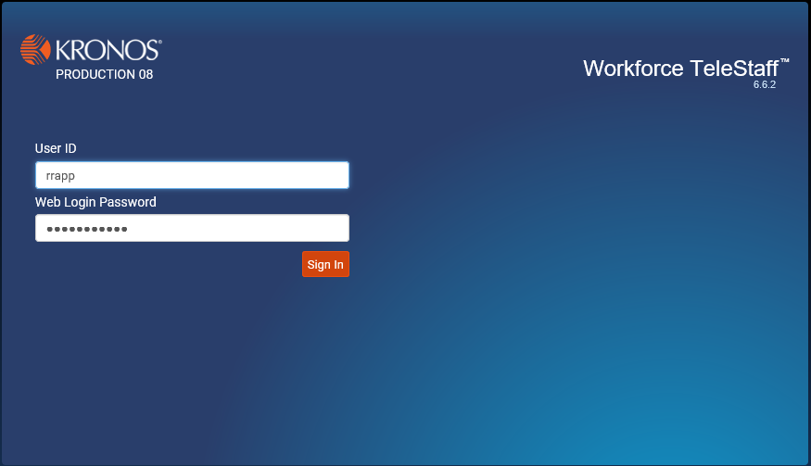
Topics
This is a brief overview of the Telestaff basics. A quick “How to” for submitting…
EXISTING PROCESSES:
#1 Telestaff tour
#2 Paid Time Off (PTO)
#3 Shift Giveaways
#4 Shift Trades
#5 Monthly Shift
Availability/Prescheduling
NEW ADDITIONAL PROCESS:
#6 Coco Callback/Picking up paged shifts

Slide 6
Topic #1 – Existing Processes
Telestaff Tour

Slide 7
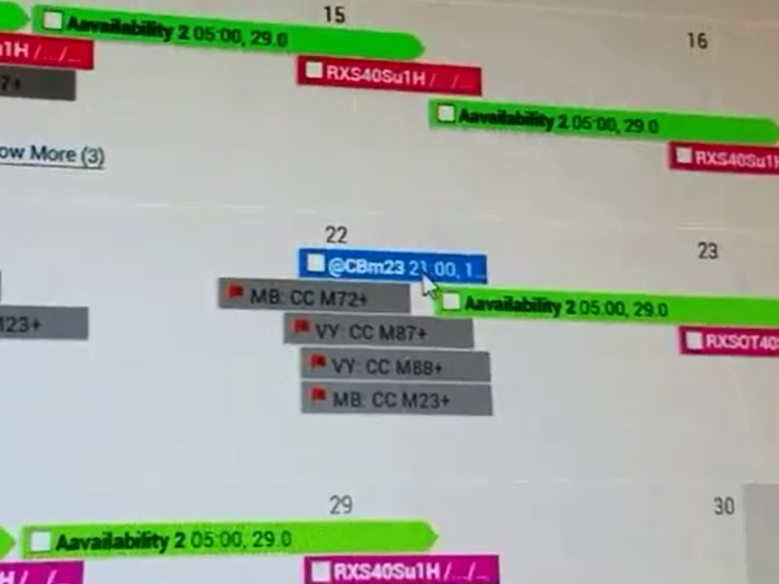
Telestaff Tour: Shift Code Definitions
Color | Description | Notes
Green | Availability | These are the shifts and/or times that you have made yourself available to work during the monthly prescheduling process (this is the process that occurs no later than the 10th of the month prior to a given month's schedule.
Blue | Call Back | This is the code used by employees to bid on shifts that are paged out through Everbridge (Weekly open shifts, same day openings, etc.). This is the new process that will replace the requirement to call into scheduling in order to pick up shifts.
Gray with Red Flag | Open shifts | These are shifts that can be bid on by employees.
Pink | Shift Award | These are shifts that are awarded to an employee.

Slide 8
Telestaff Tour: Logging into Telestaff

Slide 9
Telestaff Tour: Logging into Telestaff
Go to Https://amrwfts.kronos.net
Log in using the First letter of your First Name and your Last Name for the User ID
Enter your EMSC Portal Password

Slide 10
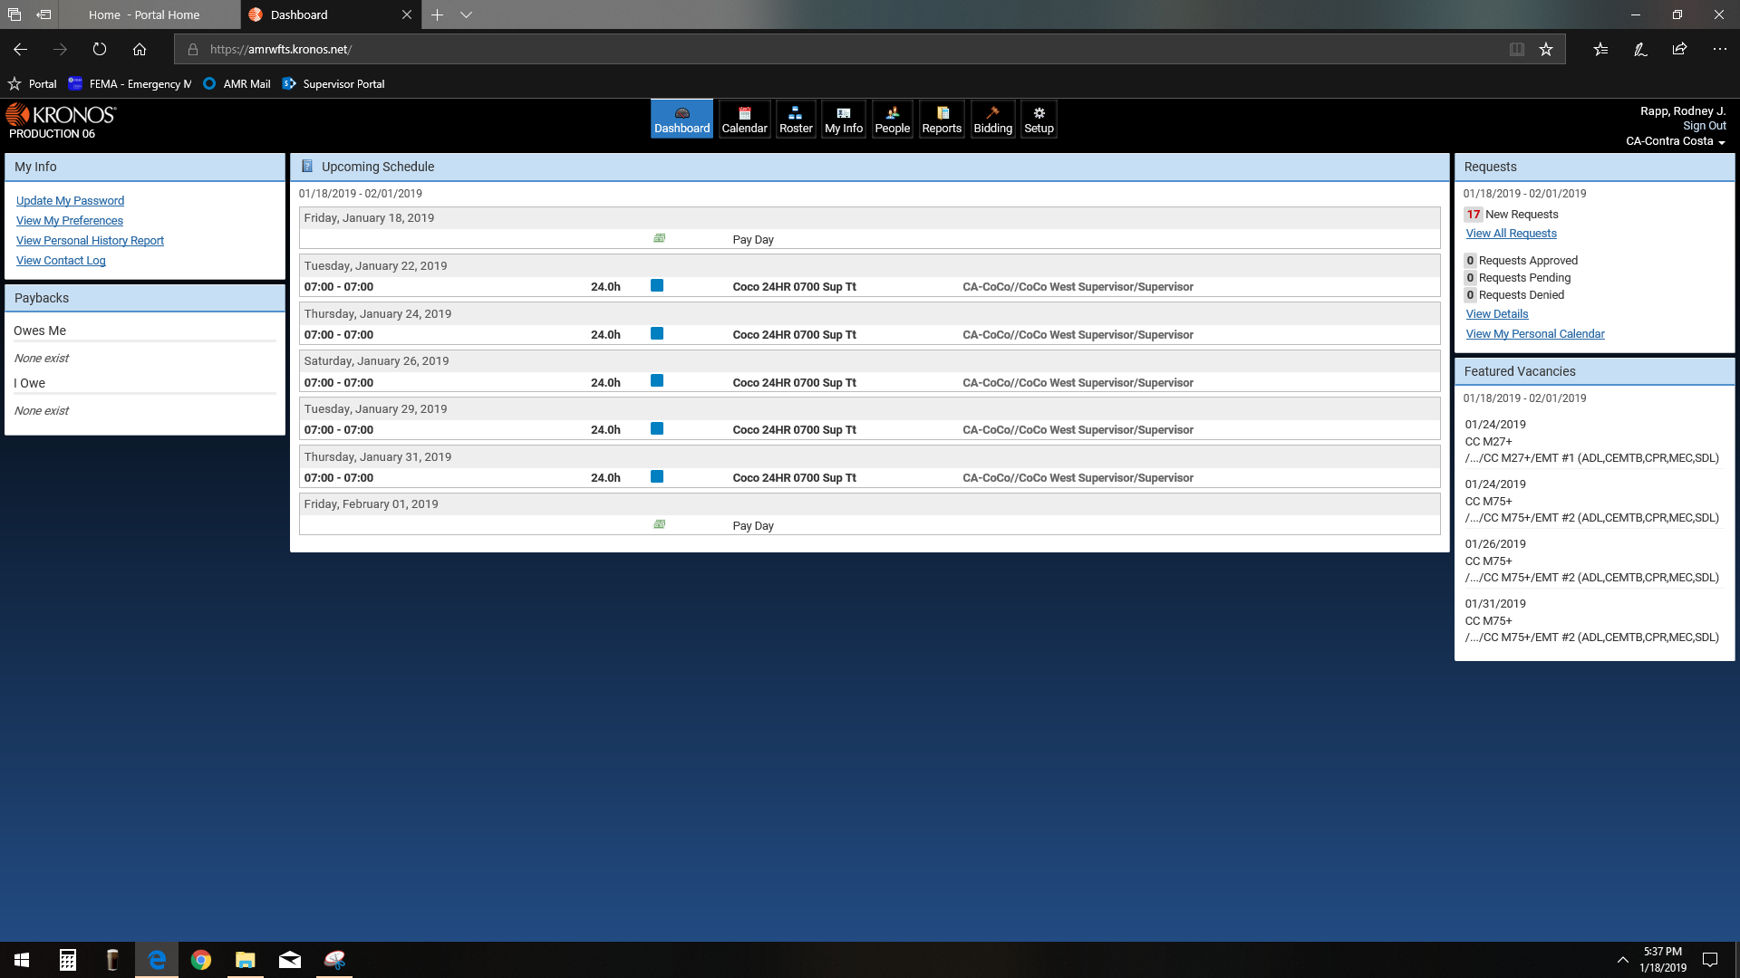
Telestaff Tour: Personal Dashboard
Log into Telestaff
Your personal Dashboard will be Displayed

Slide 11
Telestaff Tour: Accessing Calendar
At the top of your Dashboard
Select the “Calendar” Button

Slide 12
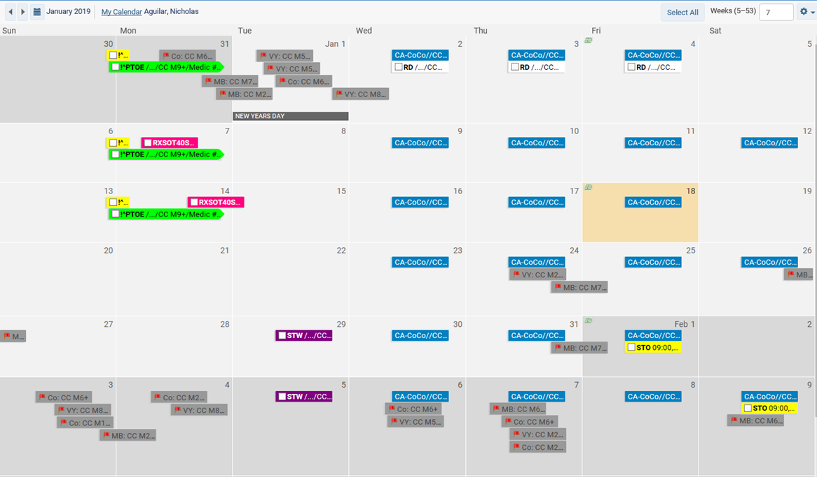
Telestaff Tour: Personal Calendar
Once you are in the Calendar screen, you can do the following:

Slide 13
Telestaff Tour: Personal Calendar
Once you are in the Calendar screen, you can do the following:
Submit PTO requests
Give Away Shifts
Process Shift Trades
Make yourself available for
shifts
Bid on open shifts.

Slide 14
Topic #2 – Submitting for
Paid Time Off (PTO)

Slide 15
PTO
Left click on the shift for which you are requesting PTO.
Click “Add”

Slide 16
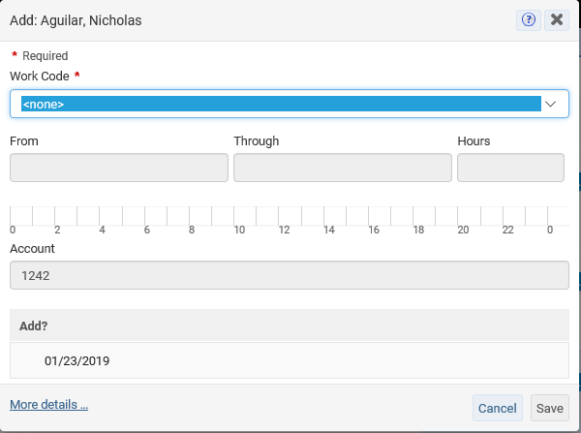
PTO
Select “PTO Requested” in the Work Code Drop Down

Slide 17
PTO
Make sure to check the boxes to be able Save request
Save the request
All requests will require approval

Slide 18
PTO
Before clicking Save your Request should look like this

Slide 19
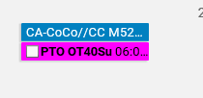
PTO
Once your request is submitted, you will see “PTOR” in Grey on the day requested
Once approved by Scheduling or Supervisor you will see PTO OT40Su in Pink on the Calendar
**Once approved, you cannot edit and will need to request changes with sup or scheduling.

Slide 20
PTO Request Review
Starting at the Dashboard
Select Calendar
Left click the date that is being given away
Select “Add”
Select “PTO Requested” in the Work Code drop down
Make sure to check the appropriate boxes to open up the “Save” option
Click “Save” in the lower right corner
In the Calendar you will see PTOR in grey on that day
Once approved, you will see PTO OT 40Su in Pink on that day
**Once approved, you cannot edit and will need to request changes with sup or scheduling.

Slide 21
Topic #3 – Existing Process
SHIFT GIVE AWAY

Slide 22
Shift Give Away
Starting at the Dashboard
Select Calendar

Slide 23
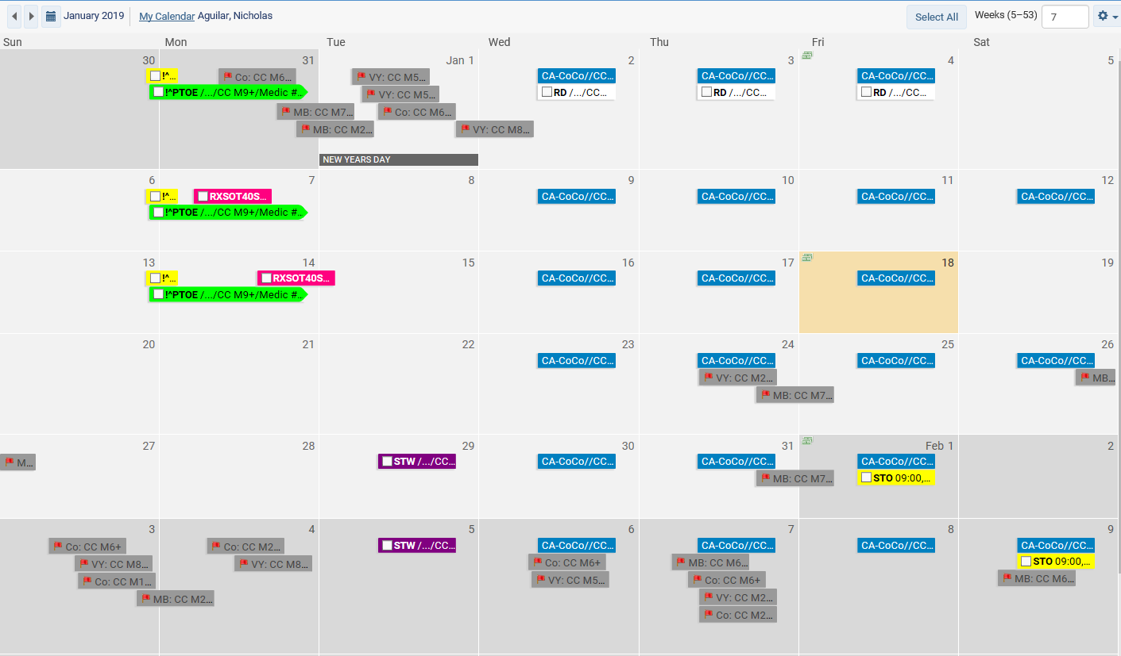
Shift Give Away
Left click shift on the date that is being given away
Select “Add”

Slide 24
Shift Give Away
Select “Shift Give Away” in the Work Code drop down
In the Cover Person box Add the Name of the person who will be working the shift

Slide 25
Shift Give Away
Make sure to check the boxes before Saving
Click Save
**Once approved, you cannot edit and will need to request changes with sup or scheduling.

Slide 26
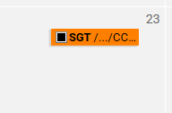
Shift Give Away
In the Calendar you will see SGA (Shift Give Away) in light blue on that day
The person working the shift will need to also log into Telestaff and accept the shift within 24 hours or the Give Away may be denied
The person working will see SGT (Shift Giveaway Taken)in orange on that day after accepting the shift and it is approved by Scheduling or Supervisor

Slide 27
Shift Give Away Review
Starting at the Dashboard
Select Calendar
Left click the date that is being given away
Select “Add”
Select “Shift Give Away” in the Work Code drop down
In the Cover Person box Add the Name of the person who will be working the shift
Make sure to check the boxes before Saving
Click Save
In the Calendar you will see SGA in light blue on that day
The person working will see SGT in orange on the scheduled day after accepting the shift and it has been approved
**Once approved, you cannot edit and will need to request changes with sup or scheduling.

Slide 28
Topic # 4 – Existing Process
SHIFT TRADES

Slide 29
Shift Trades
Starting at the Dashboard
Select Calendar

Slide 30
Shift Trade
Left click on the shift that is being traded
Select “Add”

Slide 31
Shift Trades
Select “Shift Trade Off” STO in the Work Code drop down box
In the ‘Cover Person’ field select the Name of the person who will be working the shift and the
‘Shift Trade Working’ field will auto-populate

Slide 32
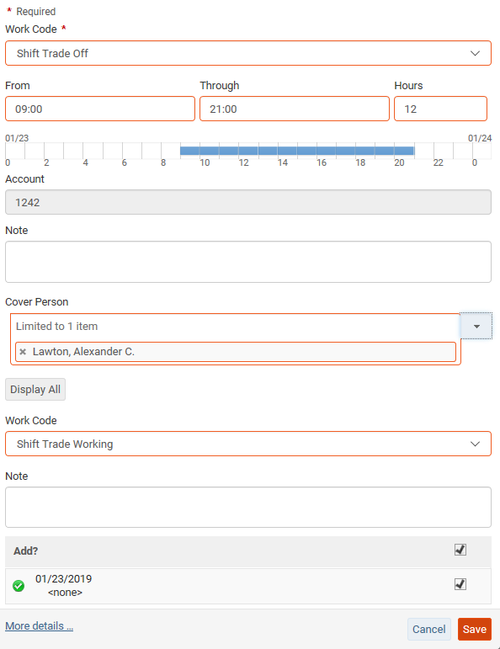
Shift Trade
Check the two boxes above ‘Save’ for the save option to become available.
Click Save
**Once approved, you cannot edit and will need to request changes with sup or scheduling.

Slide 33
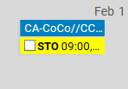
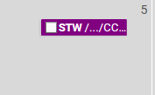
Shift Trades
Yellow coloring means you have successfully submitted your request: “STO” (Shift Trade Off)
The recipient will need to also log into Telestaff and accept the shift within 24 hours or the Shift Trade may be denied
Bright fuchsia coloring means the trade has been approved by scheduling and accepted by the recipient. The recipient will see “STW” (Shift Trade Working) in purple on that day after accepting the shift and has been approved

Slide 34
Shift Trades - Review
This process is very similar to requesting “PTO” with the addition of needing to assign the person who will be filling the shift
Starting at the Dashboard
Select Calendar
Left click the date that is being given away
Select “Add”
Select “Shift Trade Off” in the Work Code drop down
In the “Cover Person” box Add the Name of the person who will be working the shift
Make sure to check the boxes before Saving
Click Save
In the Calendar you will see “STO” in yellow on that day
The person working will see “STW” in purple on the scheduled day after accepting the shift and it has been approved
**Once approved, you cannot edit and will need to request changes with sup or scheduling.

Slide 35
Topic # 5 – Existing Process
MONTHLY SHIFT AVAILABILITY
Or PRESCHEDULING

Slide 36
Monthly Shift Availability/Prescheduling Shift Color Definitions
Green – Prescheduling availability successfully submitted
(closes on the 10th) These are not yet awarded to you.
Example - @Am6 in green is the available code
@Available on M6 or the hours you entered
Blue – Coco callback or Picking up paged shifts availability
successfully submitted (Ongoing – daily, weekly, etc.)
These are not yet awarded to you.
Gray w/red flag – ‘Coco callback/picking up paged shift’
These are vacant shifts that has been paged out which
are open to submit availability (follow coco callback process)
Pink – Shifts awarded to you; In addition to any regularly
scheduled shift. After you have submitted your availability and the shift is awarded to you, hey turn pink when they have been approved by a sup or scheduling. Once approved, you cannot edit and will need to request changes with sup or scheduling.

Slide 37
Monthly Shift Availability/Prescheduling
The window to submit monthly Availability for each month closes on the 10th of the previous month
After the 10th availability cannot be edited by the employee. Changes or edits need to be made through the sup or scheduling.
Shifts are awarded using the current assignment process by the 15th of each month.

Slide 38
Monthly Hour Availability/Prescheduling
Starting at the Dashboard
Select Calendar

Slide 39
Monthly Shift Availability/Prescheduling
Submitting Availability for Monthly Prescheduling can be one of two ways:
An Employee can submit availability for a specific shift.
An employee can submit availability for a specific day or time period.

Slide 40
Submitting Availability for a Specific Time
Left click the date selected for Availability
Select “Add”

Slide 41
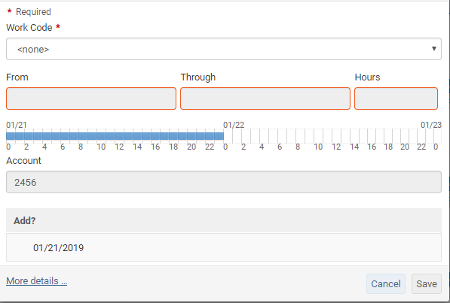
Submitting Availability for a Specific Time
Select the Work Code “Available”
In the Availability Screen there is no unit times and default is 24 hours

Slide 42
Submitting Availability for a Specific Time
The Detail Code box Will appear and must be populated to complete availability. Examples include:
West Day Car
East Strike
Central any time

Slide 43
Submitting Availability for a Specific Time
Hours must be selected for the desired work range
Once the “From” and “Though” hours have been entered It should look something like the picture below

Slide 44
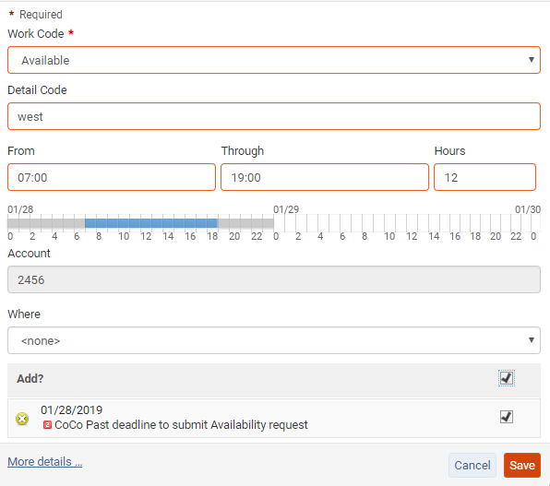
Submitting Availability for a Specific Time
After you complete Availability code, Detail Code and Times and/or specific shifts:
Check the 2 boxes
Click “Save”

Slide 45
Monthly Shift Availability for a Specific Time Review
During the monthly Availability Window (before the 10th)
Log into personal Dashboard
Select Calendar
Left click the date selected for Availability
Select “Add”
Select “Available” in the Work Code drop down
Complete all fields for ‘save’ option to become available
Hours of availability and/or shift desired must be entered
Make sure to check the all boxes before clicking ‘Save’
Click ‘Save’
In the Calendar you will see green and Pink on any day or days awarded to you
**Once approved, you cannot edit and will need to request changes with sup or scheduling.

Slide 46
Monthly Shift Availability/Prescheduling
Starting at the Dashboard
Select Calendar

Slide 47
Monthly Shift Availability for a Specific Shift
When submitting Availability for Monthly Prescheduling
an Employee can submit availability for specific shifts
Availability for Shifts can only be completed on days where there are Vacant Shifts available
The steps are similar to Submitting Availability for Monthly Prescheduling for a Specific Time

Slide 48
Monthly Shift Availability for a Specific Shift
Left click the date selected for Availability
Select “Add”

Slide 49
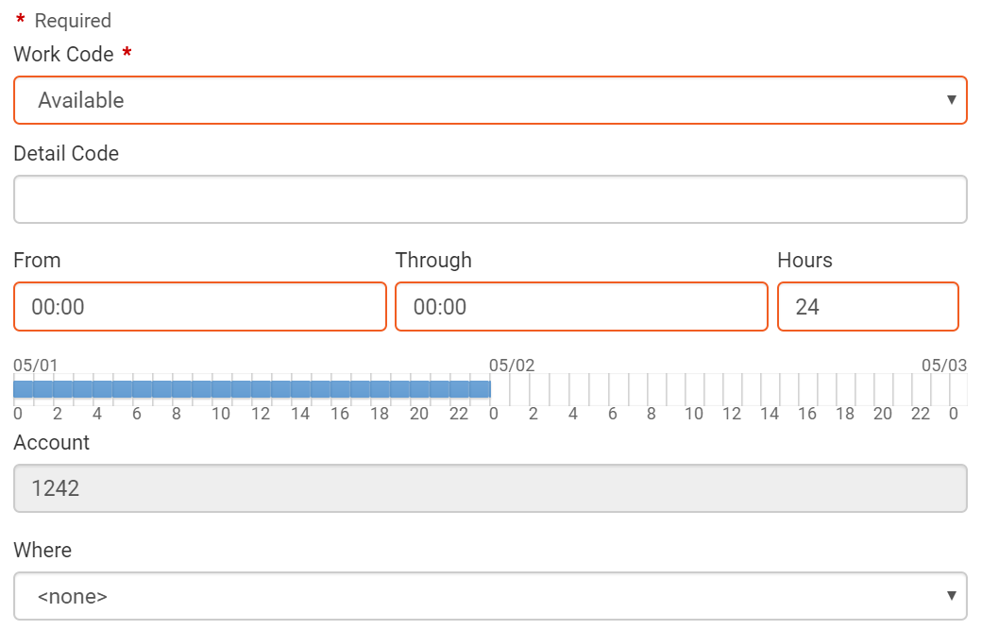
Monthly Shift Availability for a Specific Shift
In the Work Code box, select availability.

Slide 50
Monthly Shift Availability for a Specific Shift
Shifts can be selected from the Where box
Example below

Slide 51
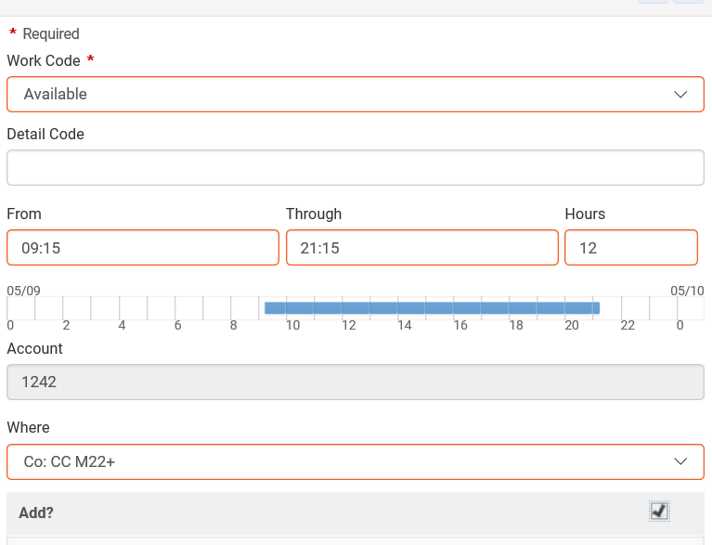
Monthly Shift Availability for a Specific Shift
After you complete Availability, Detail Code and specific shifts:
Check the 2 boxes
Click “Save”

Slide 52
Monthly Shift Availability for a Specific Shift
Review
During the monthly Availability Window (before the 10th)
Log into personal Dashboard
Select Calendar
Availability for Shifts can only be completed on days where there are Vacant Shifts available
Left click the date for Availability
Select “Add”
Select “Available” in the Work Code drop down
Shift availability desired must be entered in the Where box
Make sure to check the all boxes before clicking ‘Save’
Click ‘Save’
In the Calendar you will see Blue and Pink on any day or days awarded to you
**Once approved, you cannot edit and will need to request changes with sup or scheduling.

Slide 53
Topic # 6 – NEW Process
Coco Callback/
Picking up paged shifts
Past Process: You call scheduling to pick up paged shifts
NEW PROCESS: Use Telestaff

Slide 54
Coco Callback/picking up paged shifts: Shift Color Definitions
Green – Prescheduling availability successfully submitted
(closes on the 10th) These are not yet awarded to you.
Example - @Am6 in green is the available code
@Available on M6 or the hours you entered
Blue – Coco callback or Picking up paged shifts availability
successfully submitted (Ongoing – daily, weekly, etc.)
These are not yet awarded to you.
Gray w/red flag – ‘Coco callback/picking up paged shift’
These are vacant shifts that has been paged out which
are open to submit availability (follow coco callback process)
Pink – Shifts awarded to you; In addition to any regularly
scheduled shift. After you have submitted your availability and the shift is awarded to you, hey turn pink when they have been approved by a sup or scheduling. Once approved, you cannot edit and will need to request changes with sup or scheduling.

Slide 55
Coco Callback: Picking Up Open Shifts
Starting at the Dashboard
Select Calendar

Slide 56
Coco Callback: Picking Up Open Shifts
Left click the shift that you want to put in for
Select “Add”

Slide 57
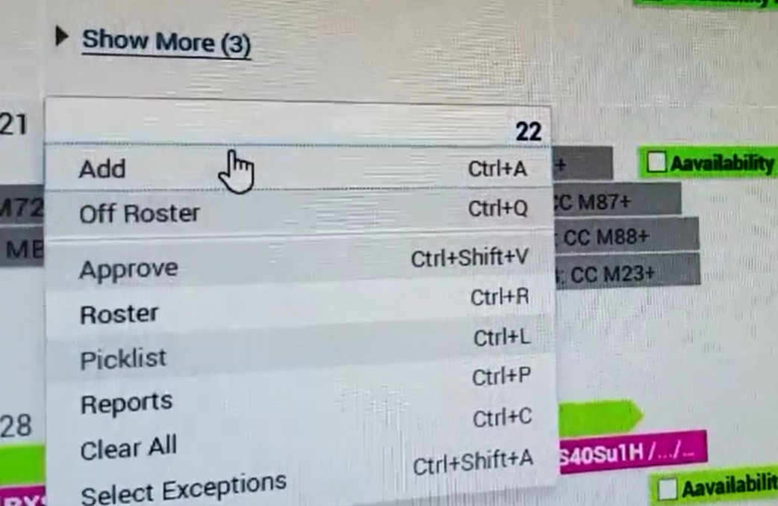
Coco Callback/Picking up paged shifts
Left click the date that is being given away
Select “Add”

Slide 58
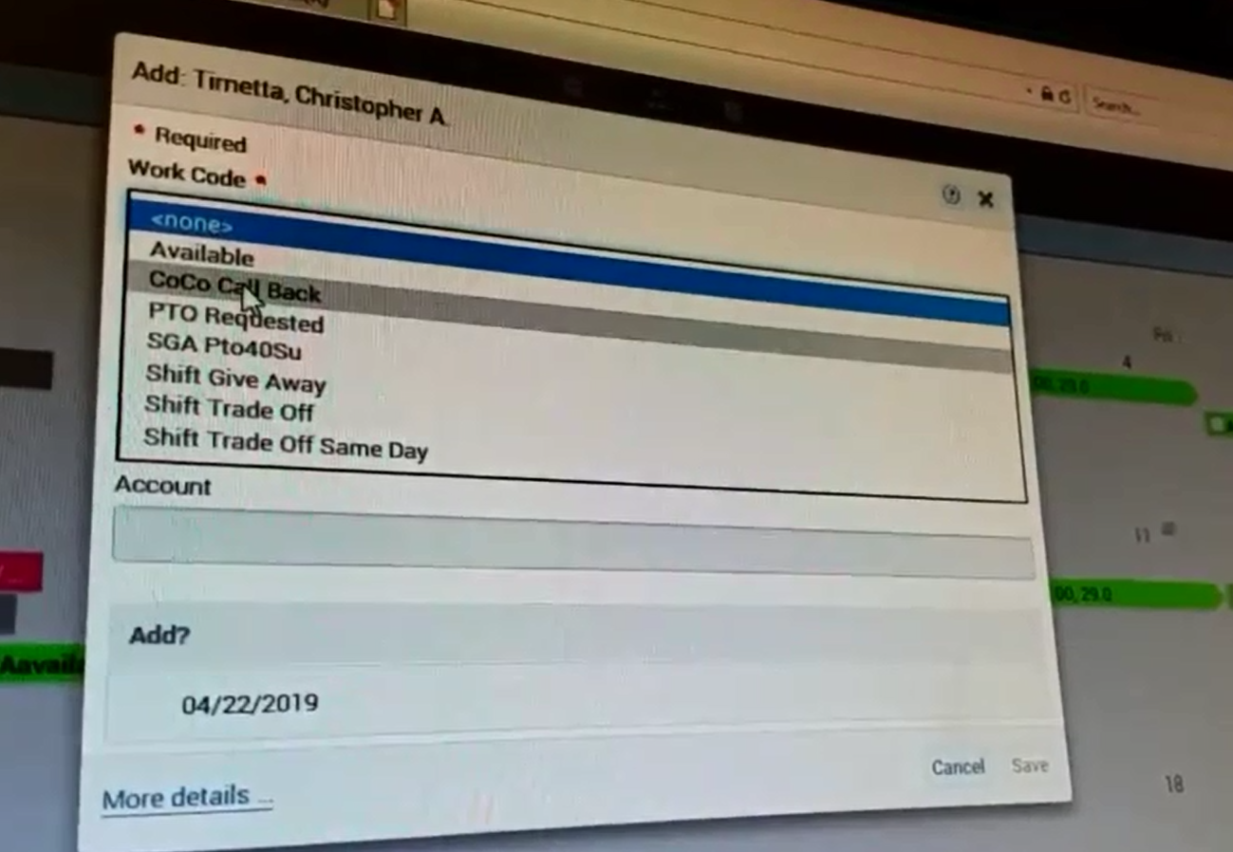
Coco Callback/Picking up paged shifts
Select “CoCo Call Back”

Slide 59
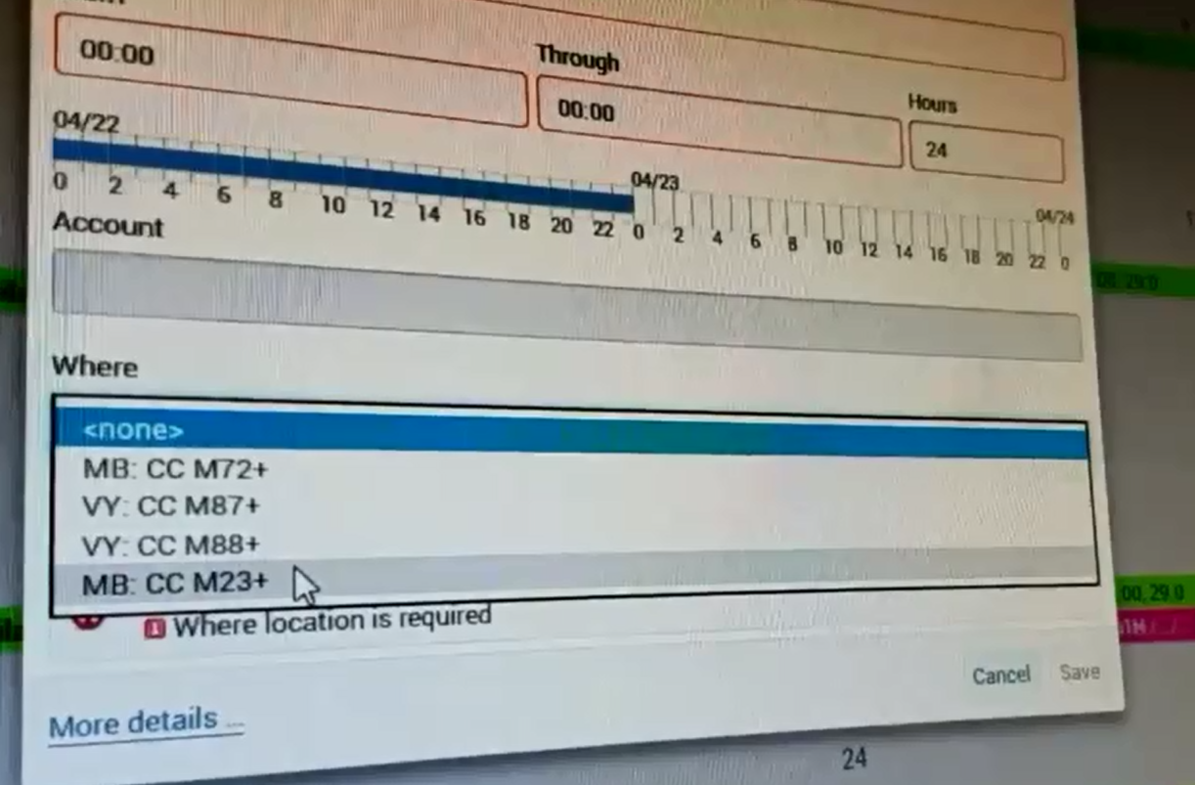
Coco Callback/Picking up paged shifts
Select the shift you interested in the “Where” field
Verify the hours of the shift

Slide 60
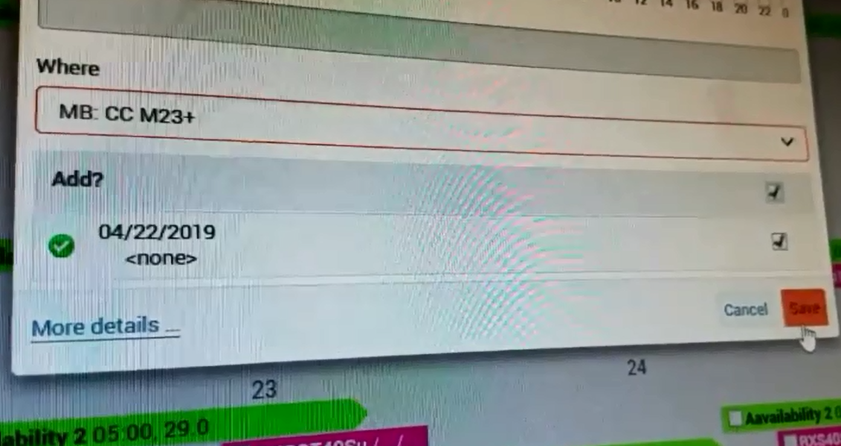
Coco Callback/Picking up paged shifts
Check the 2 boxes above ‘Save’
Click Save
**Once approved, you cannot edit and will need to request changes with sup or scheduling.

Slide 61
Coco Callback/Picking up paged shifts
Once an open shift has been paged to the field you will have 30 minutes to log into Telestaff to put in your interest for the shift
Log into personal Dashboard
Select Calendar
Left click the flagged shift
Select “Add”
Select “CoCo Call Back” in the Work Code drop down
Complete all fields for ‘save’ option to become available
shift desired must be entered
Make sure to check the all boxes before clicking ‘Save’
Click ‘Save’
In the Calendar you will see Blue and Pink on any day or days awarded to you
**Once approved, you cannot edit and will need to request changes with sup or scheduling.

Slide 62
Resources: Coco Callback/picking up paged shifts: Shift Color Definitions
Green – Prescheduling availability successfully submitted
(closes on the 10th) These are not yet awarded to you.
Example - @Am6 in green is the available code
@Available on M6 or the hours you entered
Blue – Coco callback or Picking up paged shifts availability
successfully submitted (Ongoing – daily, weekly, etc.)
These are not yet awarded to you.
Gray w/red flag – ‘Coco callback/picking up paged shift’
These are vacant shifts that has been paged out which
are open to submit availability (follow coco callback process)
Pink – Shifts awarded to you; In addition to any regularly
scheduled shift. After you have submitted your availability and the shift is awarded to you, hey turn pink when they have been approved by a sup or scheduling. Once approved, you cannot edit and will need to request changes with sup or scheduling.

Slide 63
Resources:
Walkthroughs, Tips, and Tricks are available at:
AMRcoco.com

Slide 64
Resources: Coco Callback/Picking up paged shifts

Slide 65
Troubleshooting Telestaff
If there are any Telestaff issues contact a Supervisor
For time sensitive Issues (less than 24 hours)
Contact The Supervisors First
Central Supervisor 925-250-9546
East Supervisor 925-250-8553
West Supervisor 925-250-8552
Any other non immediate issues will be
forwarded to Scheduling
concordscheduling@evhc.net

Slide 66
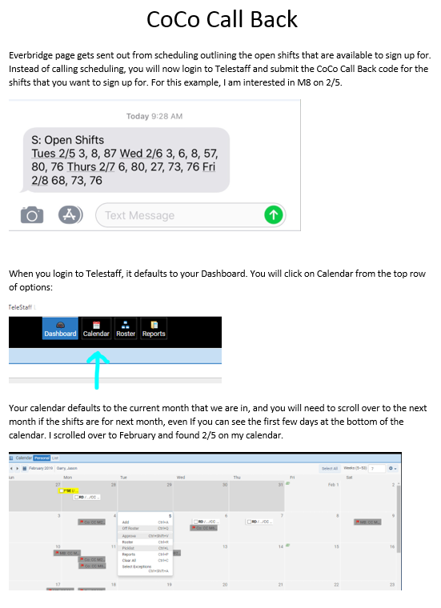
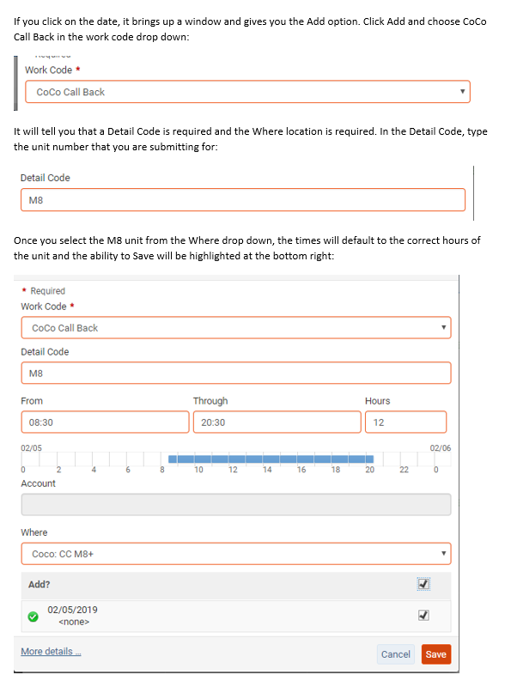
Resources: Coco Callback/Picking up paged shifts

Slide 67
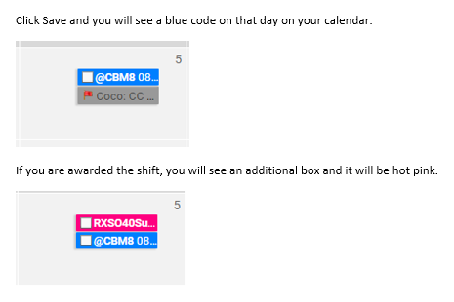
Resources: Coco Callback/Picking up paged shifts

Slide 68
Telestaff Workflow
1. Attempt to process all steps in Telestaff yourself using the resource and training tools
2. Urgent issues with 24 hour timeline?
Contact the Supervisor with assistance and questions; They will guide you to the next process
concordscheduling@evhc.net
Central Supervisor 925-250-9546
East Supervisor 925-250-8553
West Supervisor 925-250-8552

